Slide 1
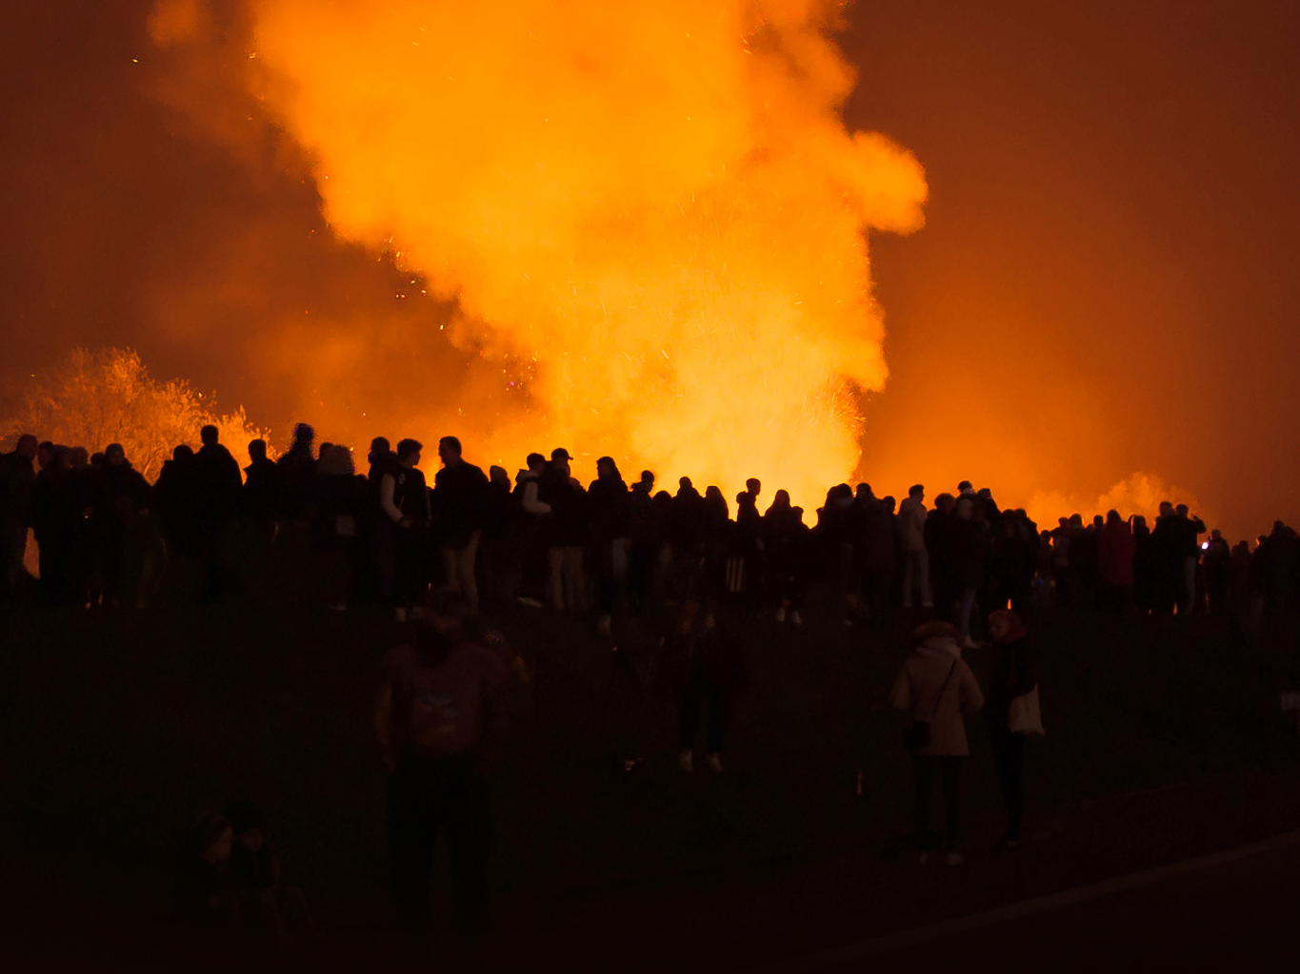

Bonfire and firework talk
Bonfire and Firework Talk
Prepared for Prepared by Revision Revision Date
Schools Prevention Training Team 02 July 2027

Slide 2
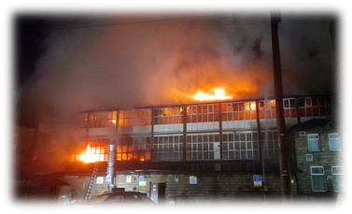
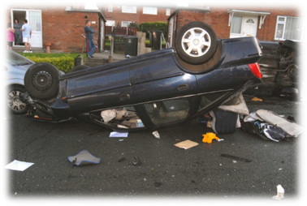
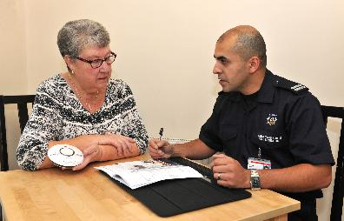
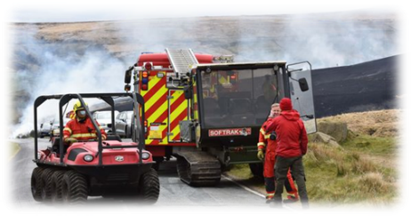
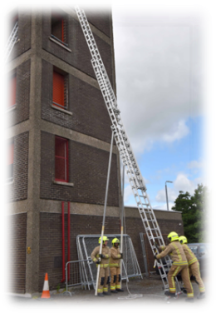
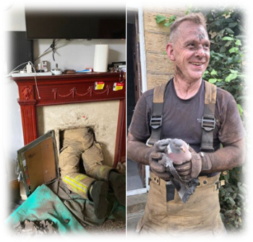
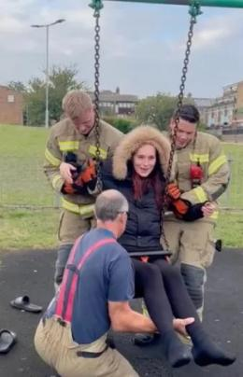
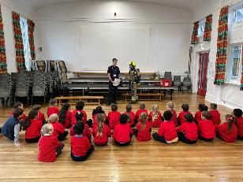
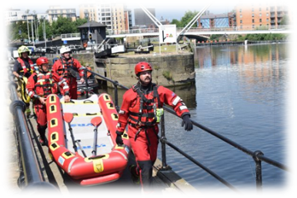

Who are we? What do we do?
westyorksfire.gov.uk/celebrate-safely
In an emergency, always dial 999.
Notes:
Introduction:
Introduce yourselves
Which station are you from?
What is your job role?
Why did you become a firefighter? Each FF give reasons.
What sort of jobs do we do? Not just fire – focus on the rescue too.

Slide 3
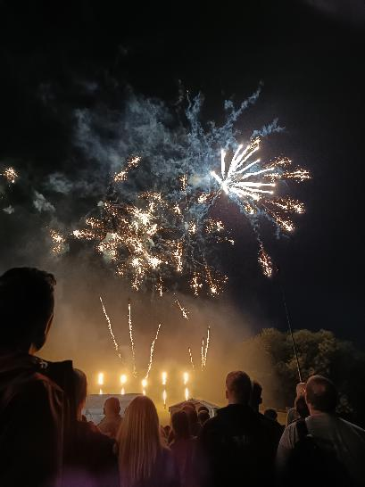
Why are we here today? What day is approaching?
Learn about the dangers of bonfires and fireworks
Learn what ASB is
Learn about the consequences
- Primary aim of being a Firefighter – to save lives and help make communities safer
13 October 2026
westyorksfire.gov.uk/celebrate-safely
In an emergency, always dial 999.
Notes:
Discuss the 3 learning aims.
Point out last statement and explain.

Slide 4
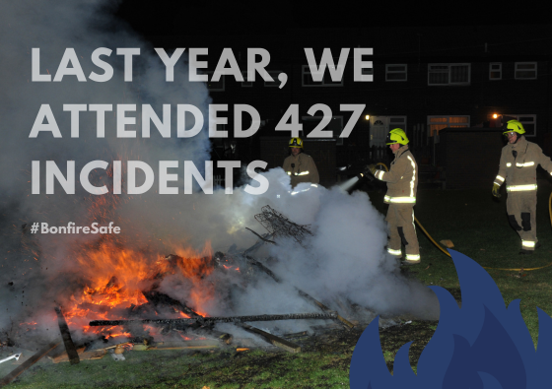
Bonfire and Firework Dangers
13 October 2026
westyorksfire.gov.uk/celebrate-safely
In an emergency, always dial 999.
4
Notes:
Explain that some of these incidents will have been accidental, and some deliberate. But this is only in West Yorkshire, that’s a lot in one period on top of all other incidents such as car crashes, other house fires etc.

Slide 5
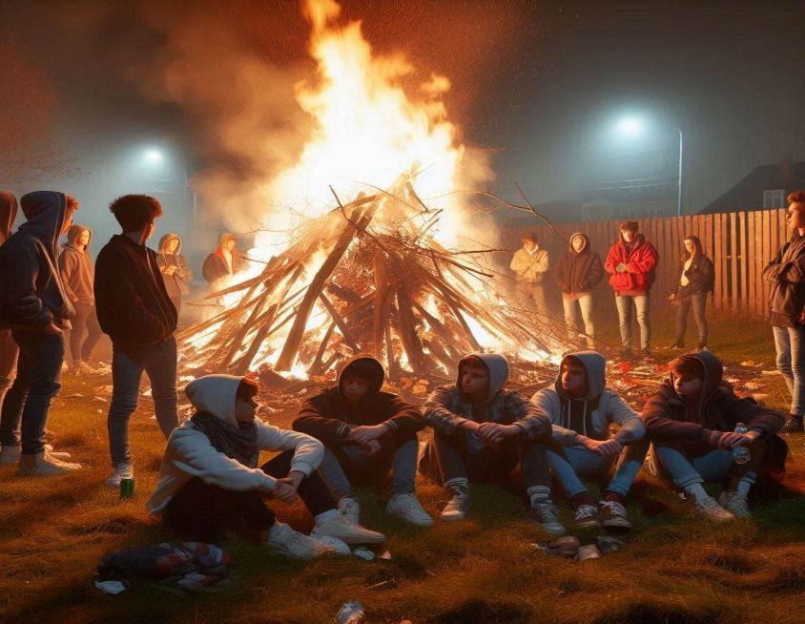
Bonfire Dangers
Why are bonfires so dangerous?
Bonfire alight on grass
Too close to a wooden fence.
People too close
Rubbish spread out but close to the fire
Some have their backs to the fire
Any cans or bottles could explode
Could have been animals hid or hibernating in the bonfire before it was lit
13 October 2026
westyorksfire.gov.uk/celebrate-safely
In an emergency, always dial 999.
5
Notes:
Talk through each one, explaining why each one is dangerous.
N.B. For the animals hidden – Mention it could be someone’s pet!

Slide 6
Check for Dangers Before Lighting
4
01
LOCATION
Is the bonfire on grass or too close to a wooden fence?
things to check
before lighting
02
PEOPLE
Are people too close or facing away from the fire?
03
DEBRIS
A grown-up must be responsible for checking and lighting the bonfire.
Is loose rubbish nearby? Remove any cans or bottles.
04
WILDLIFE
Check inside: could animals be hiding or hibernating in the pile?
13 October 2026
westyorksfire.gov.uk/celebrate-safely
In an emergency, always dial 999.
6
Notes:
Reflection from previous slide to discuss and remind the pupils
Remember – Grown ups are responsible for checking and lighting the bonfire

Slide 7
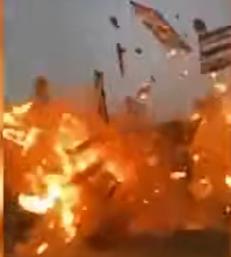
Bonfire Dangers
WARNING:
You’re about to see a short video of a bonfire exploding. Please look away and cover your ears if you do not wish to watch/hear.
Click on the image to play the video
13 October 2026
westyorksfire.gov.uk/celebrate-safely
In an emergency, always dial 999.
7
Notes:
Explain context: This is an adult setting alight a bonfire for a school celebration at a relatively safe distance from everyone.
Watch what happens......
After video:
The bonfire had been a school tradition for 50 years, nothing like this had ever happened before. The cause of the explosion is unknown. The school district said no one was injured in the explosion and bonfires and similar events are now prohibited at this school.
Do you think the school would have gone ahead with this bonfire had they known what would happen? Of course not. The point is, we never know when something might go wrong.

Slide 8
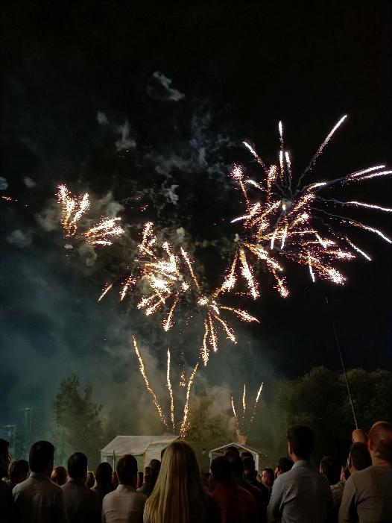
Firework Dangers
Why are fireworks so dangerous?
Fireworks are essentially EXPLOSIVES!
Loss of fingers/hands
Leaving you permanently scarred
Needing skin graft surgery for the rest of your life due to burns, possibly on your face and/or body
They are not toys!
13 October 2026
westyorksfire.gov.uk/celebrate-safely
In an emergency, always dial 999.
8
Notes:
Firework Dangers
PRIMARY – Ask the children for hands up to say what they think is so dangerous about fireworks
SECONDARY – Just leave the question as a rhetorical question.
Explain Messing with fireworks, or even keeping fireworks in your pockets, and they go off unexpectedly, could leave you with serious, life changing injuries.
Feel free to expand on each one, explaining things like – it might be more than just your fingers/hands, and life changing injuries/permanently scarred could include blindness, and needing re-structure of your face etc if a firework goes off in your face.

Slide 9
Firework Dangers
Messing around with fireworks can result in somebody’s death.
It could be YOU!
Stay safe—always attend an organised bonfire and firework display with a grown-up.
Never play with fireworks.
13 October 2026
westyorksfire.gov.uk/celebrate-safely
In an emergency, always dial 999.
9
Notes:
It could be you!...
Or... it could be a friend!
Could you live with yourself knowing that they died because of you?!
As we said earlier in those videos where a bonfire and fireworks went wrong, they didn’t know the accident was going to happen, it just did. In the bonfire one, they’d had 49 years of it not going wrong, they weren’t expecting it at all.

Slide 10
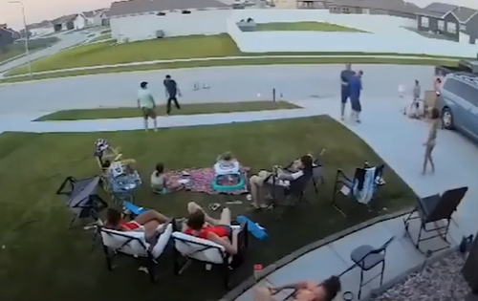
Firework Dangers
WARNING:
You’re about to see a short video of fireworks exploding. Please look away and cover your ears if you do not wish to watch/hear.
Click on the image to play the video
13 October 2026
westyorksfire.gov.uk/celebrate-safely
In an emergency, always dial 999.
10
Notes:
Read Warning.
These are adults setting off bought fireworks at a relatively safe distance from everyone.
Watch what happens......
After video:
Fireworks can go wrong!
Even if you’re trying to be as safe as possible.
Only a few sparks landed in the remaining fireworks to cause this catastrophe.
Again, like the bonfire video, these adults were trying to be safe but were not safe enough. Although everyone escaped without injury, it’s cost them a car! And had it been a crowded event, they wouldn’t have escaped so easily. They didn’t plan this event knowing this would happen, or they wouldn’t have done it, but that’s the things with accidents, we don’t know when they are going to happen, or otherwise we’d avoid it.

Slide 11
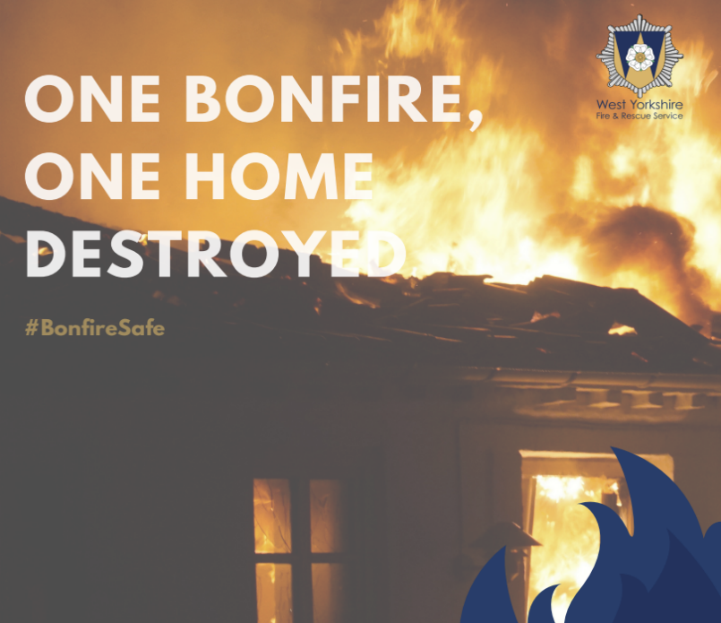
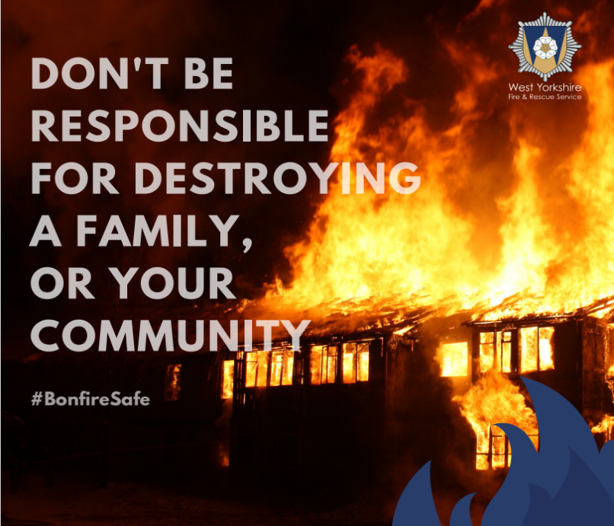
Consequences of playing with fire or fireworks
13 October 2026
westyorksfire.gov.uk/celebrate-safely
In an emergency, always dial 999.
11
Notes:
You have seen how bonfires and fireworks can go wrong, even when the intentions were genuine and just trying have a good time.
Playing around with bonfires or fireworks can lead to:
Someone losing their life
Bonfires getting out of control or exploding causing serious damage to property that may or may not be yours.
Someone could lose their home and all their belongings, which could also include their pets and loved ones.
Serious and life changing injuries to you, or someone else.
What would you say to these people if you were the reason, or even part of the reason? Would you be prepared for the upset it would cause the community in which you live....a lot of people would be very angry and upset.
You could also end up with a criminal record or even time in prison on top of all of this, possibly spoiling any future plans you may have.
is it worth a lifetime of after-effects for a few moments of fun with your mates?

Slide 12
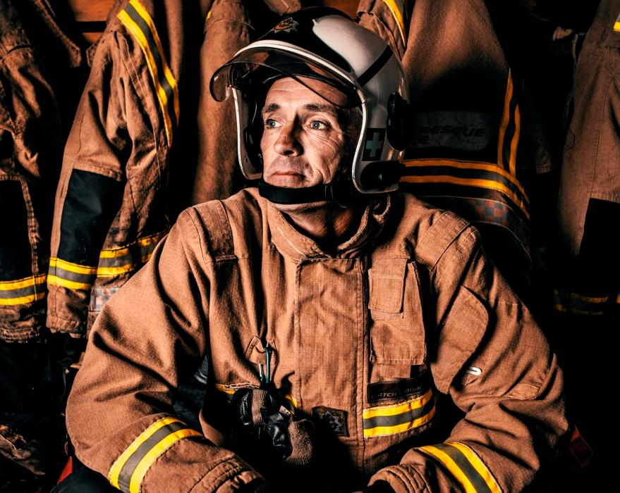
Bonfire and Firework Dangers for firefighters
Every year, emergency workers are attacked while trying to help others.
We’re not here to tell you off—we’re here to keep you and your family safe.
13 October 2026
westyorksfire.gov.uk/celebrate-safely
In an emergency, always dial 999.
12
Notes:
Now let’s look at Bonfire and Firework Dangers for firefighters.
Every year, firefighters and other emergency workers, come under attack by members of the public.
This is especially around Bonfire Night.
This isn’t just in our area, but all over the country.
We are firefighters because we want to help people and save lives.
We are not here to “tell you off” or “tell you what to do”, but we simply want to help keep you, and your families safe.

Slide 13
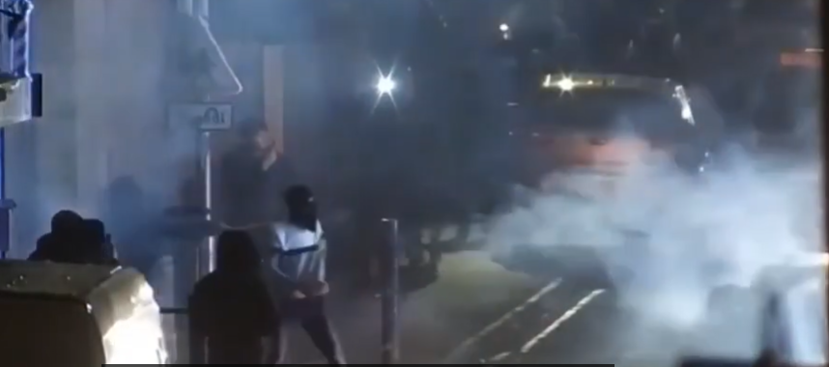
Bonfire and Firework Dangers for firefighters
The following video highlights the dangers emergency service workers face around Bonfire Night.
Click on the image to play the video
13 October 2026
westyorksfire.gov.uk/celebrate-safely
In an emergency, always dial 999.
13
Notes:
Read the message then follow on to explain:
This isn’t a one-off.
It happens every year across the UK.

Slide 14
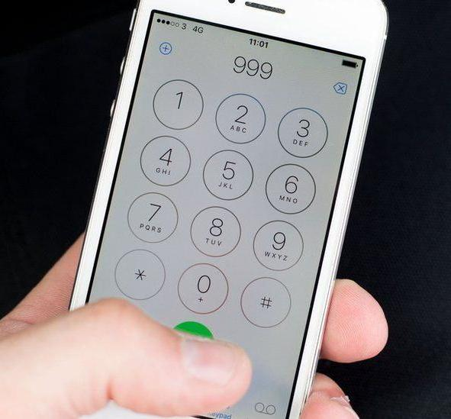
Firework Dangers for firefighters and ASB
These hoax calls are not fake, they really happen.
ASB = Anti-Social Behaviour
Anti-Social Behaviour means doing things that bother or harm other people in the community. It’s about actions that make public places less safe or enjoyable for everyone. This could include:-
13 October 2026
westyorksfire.gov.uk/celebrate-safely
In an emergency, always dial 999.
14
Notes:
These hoax calls are not fake, they really happen.
All emergency workers, including us, must respond to these calls, whether suspicious or not, and they/we set off with the aim of saving lives.
We should not be going there threatened with losing our own lives, all for a laugh with your mates!

Slide 15
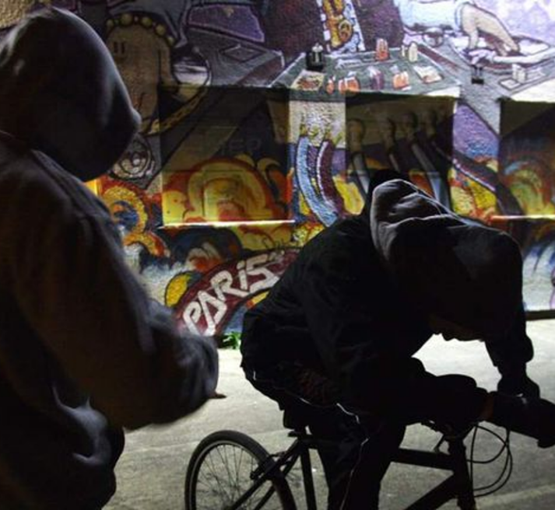
Examples of ASB
Causing physical harm to others
Damaging property like vandalism or graffiti
Using hurtful or disrespectful language
Deliberately setting fires
Hanging around places, making others feel uncomfortable
Making hoax calls
Causing noise and nuisance
13 October 2026
westyorksfire.gov.uk/celebrate-safely
In an emergency, always dial 999.
15
Notes:
The age of criminal responsibility is just 10 years old! Meaning you can get a get a criminal record from the age of only 10.

Slide 16
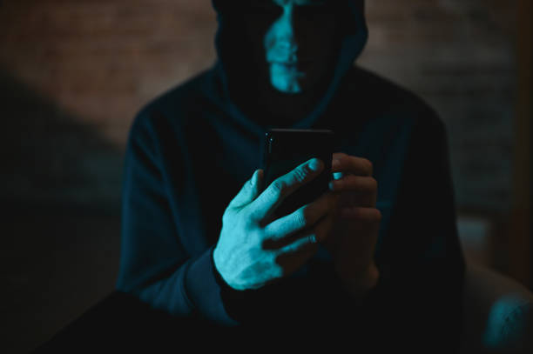
Consequences of hoax calls
Fire Station 2
20 mins
Fire Station 1
7 mins
7 mins
Hoax Call
12 mins
Real Incident
13 October 2026
westyorksfire.gov.uk/celebrate-safely
In an emergency, always dial 999.
16
Notes:
Explain:
There are only 40 fire stations across the whole of West Yorkshire, and only 46 fire engines.
Meaning 34 of those stations only have 1 fire engine.
Only 6 major stations have 2!
That’s only around 1 engine per 17 miles on average; and that’s providing none of the 46 have been damaged, or the firefighter crew have been injured already by accidental or DELIBERATE firework damage, which means there could be even less available, and further distance for them to get to you.
So, imaging the following is a map...Let’s see a visual example to demonstrate:
Here is your closest fire station
Here is the location of a hoax call.
It takes on average just over 7 minutes for a fire engine to reach the scene of an incident.
Meanwhile, there is another 999 call for a real incident (house fire) within Fire Station 1’s vicinity.
As Fire Station engine 1 is on the way to the hoax call, Fire station 2 is called out.
Problem is, this is much further away and will take around 20 minutes to reach the real incident location...
Explain that an average room in a house will take around 3 minutes to fully ignite. If a fire engine can get there in the usual response time, it can get there when only just over 2 rooms have been destroyed by fire.
However, in 20 minutes, the whole house could be alight, and it may not be possible to save anyone...
Even if the 1st fire engine finds out it’s a hoax call and only then does the 2nd call take place, they are still now further away than if travelling from the station.
All because someone has decided to waste emergency services time, or worse, lure them into danger to intentionally hurt them. Meanwhile, other innocent people may lose their lives!
It should have only taken 7 minutes for the fire engine to reach the real incident.
Which could have avoided a whole house in flames and any loss of life.
Like we saw in the video earlier, emergency services being delayed for a hoax call could literally become the difference between life and death for somebody else in a real, life-threatening emergency.
What if it was you in the real emergency? How would you feel about the person who made the hoax call and put you in more danger, or possibly made you lose a loved one as a result?
Emergency services can’t be everywhere at the same time.

Slide 17
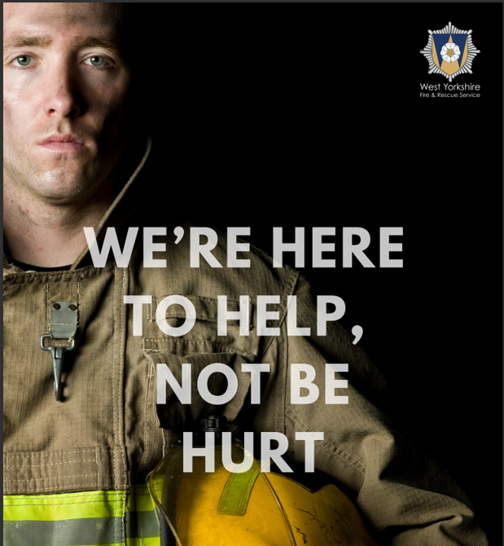
Summary
Our advice to you:
Don’t play with fire or fireworks – it can leave you scarred for life or in prison, or both!
Avoid anyone playing with fire or fireworks – Don’t gamble your life by throwing those dice.
If you are out at night, keep to public paths and lit areas – avoid getting caught up in ASB and getting a criminal record.
Don’t make hoax calls or attack Emergency services - Let all the emergency services do their job – Saving lives – Remember we all have families too!
13 October 2026
westyorksfire.gov.uk/celebrate-safely
In an emergency, always dial 999.
17
Notes:
Bonfire night is our busiest time of the year due to ACCIDENTAL and DELIBERATE firework or bonfire emergencies, as well as the many hoax calls we receive.
This is on top of all the other usual emergencies like: Car crashes, normal house fires, animal rescues, people trapped/fallen etc.
We can’t be everywhere at the same time!

Slide 18
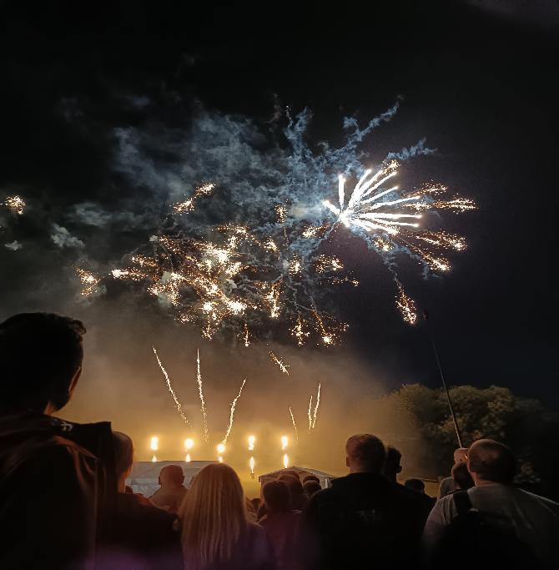
Remember
Attend Professional Displays
Inform Adults
Check Safety Advice
13 October 2026
westyorksfire.gov.uk/celebrate-safely
In an emergency, always dial 999.
18
Notes:
Remember:
We’re not saying not to enjoy Bonfire night and fireworks, but we would please advise you to:
Attend Professional Displays: Please go to professionally organized events and follow their safety rules.
Inform Adults: If adults are thinking of hosting a private celebration, please explain to the adults about the dangers and accidents that you’ve witnessed today with fireworks and bonfires.
Check Safety Advice: If the adults still wish to go ahead with a private event, please ask them to visit our website for safety advice
It is important to add that for all of you here - buying, owning or even simply holding onto an unlit firework under the age of 18, is ILLEGAL! Please bear this in mind on top of all the other dangers and consequences.
Your teachers should have a follow-up lesson to explain to you all the legalities around fireworks for your awareness.

Slide 19


Thank you for listening
Please complete our feedback
WYFRS Teacher School Visit Survey
13 October 2026
westyorksfire.gov.uk/celebrate-safely
In an emergency, always dial 999.
19
Notes:
Thank you for listening

