Slide 1
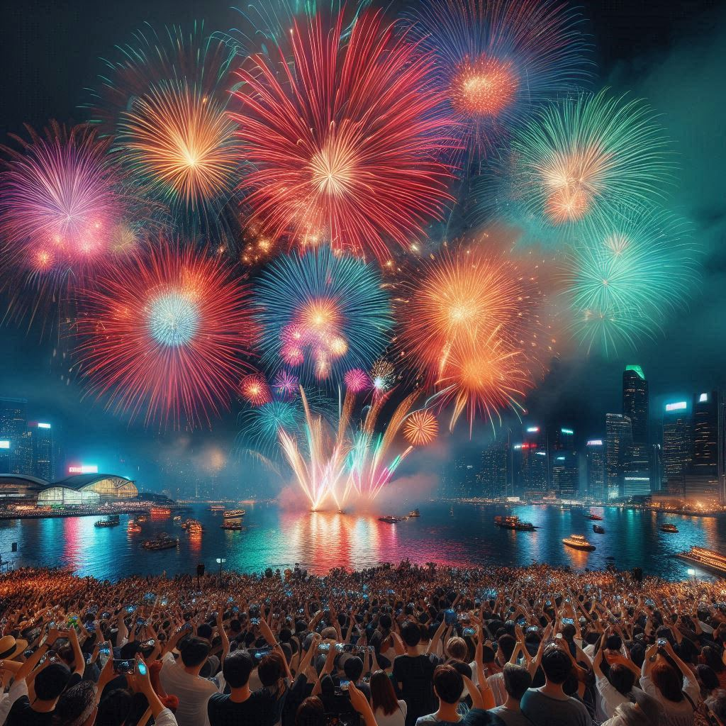
Firework legalities
Prepared for Prepared by Revision Revision Date
Schools Prevention Training Team 01 July 2025

Slide 2
Objective:
To learn about the laws around fireworks

Slide 3
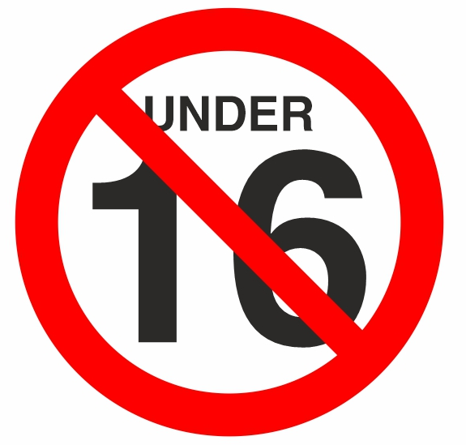
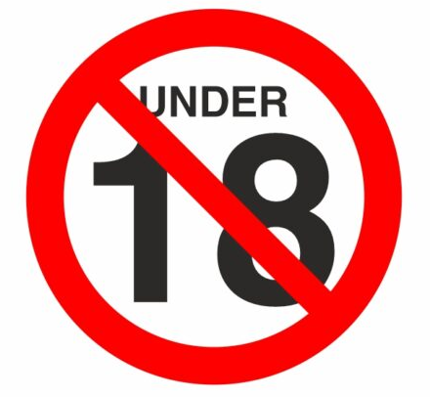

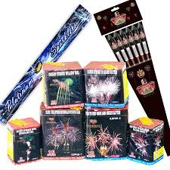
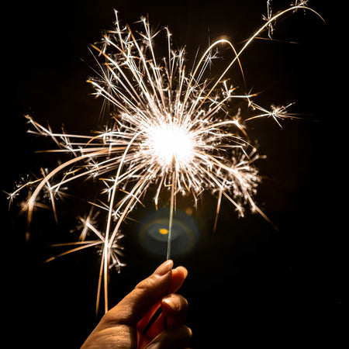
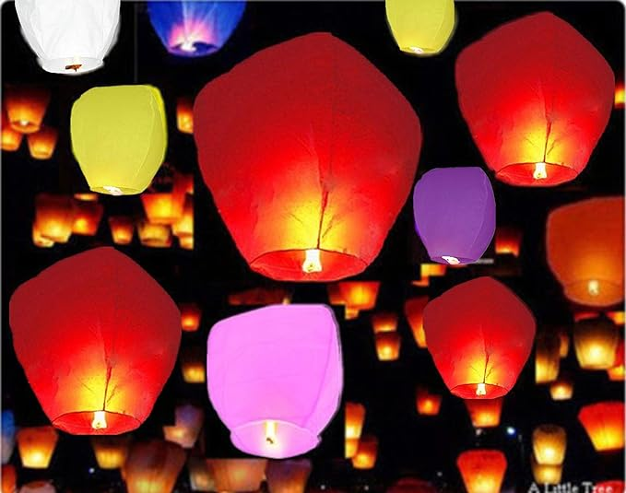
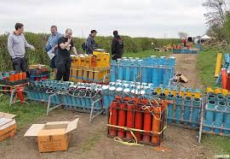
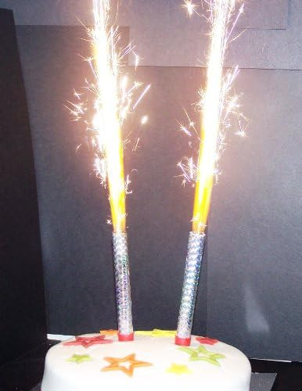
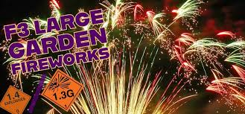

Fireworks and the law
It is illegal to be in possession of, buy OR use fireworks under the age of 18.
You could end up with a criminal record for only being in possession of them.
It is also illegal, at any age, to fire fireworks into, or to set fireworks off, in public spaces, ie. Parks, public paths and pavements, on or near roads.
You can get a criminal record from the age of just 10!
Hands up if you think it is ok and legal to just simply hold/be in possession of unlit fireworks (F2 and F3) in public, but don’t light them, if you are under 18?
There are 4 categories of fireworks:
How old do you think you need to be to buy any of these, or are you even allowed?
F1
F2 and F3
F4
PUBLIC
Professional Display Fireworks

Slide 4
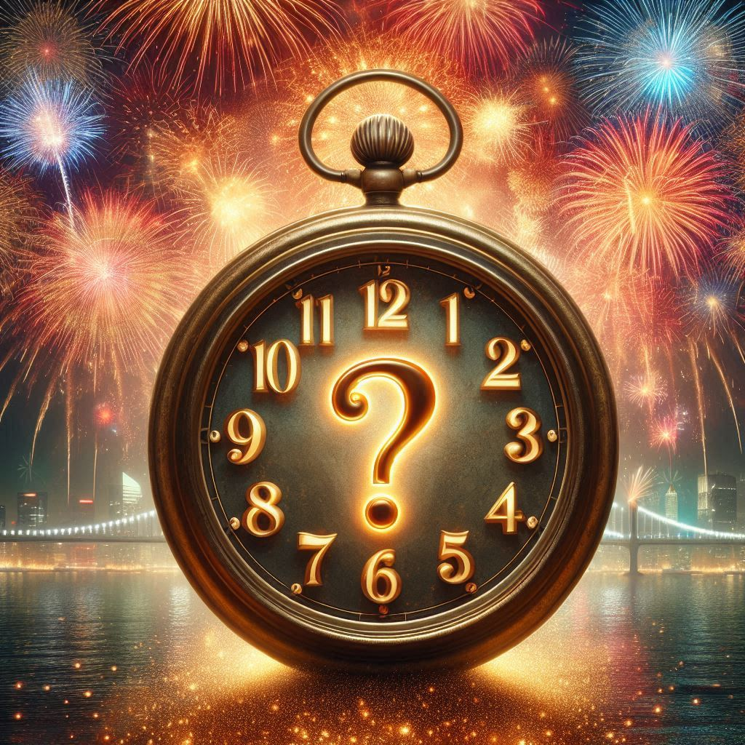
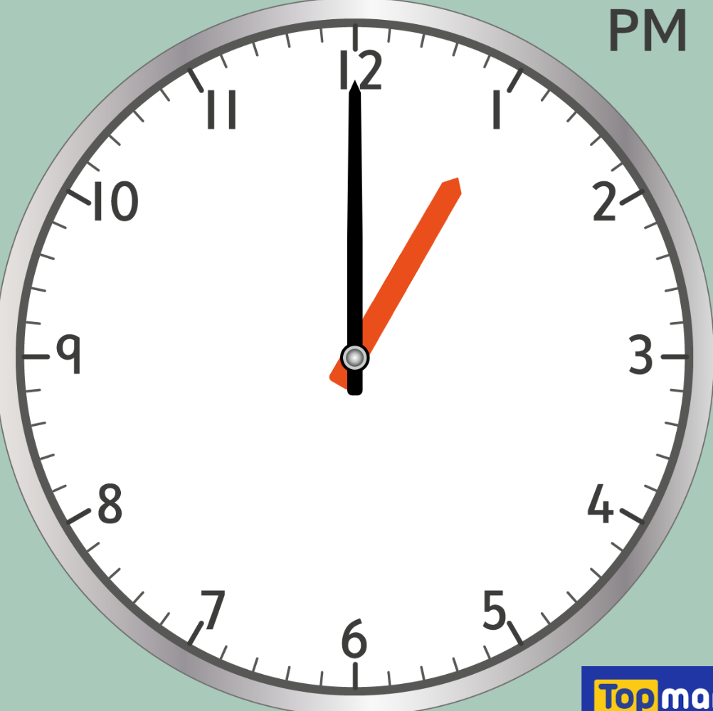
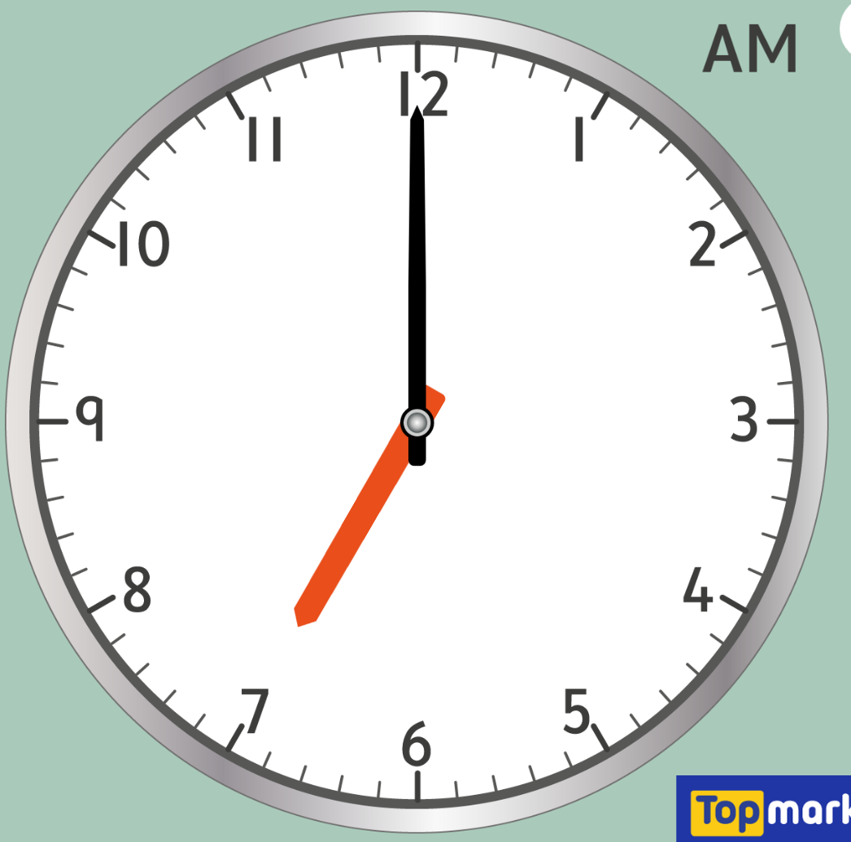
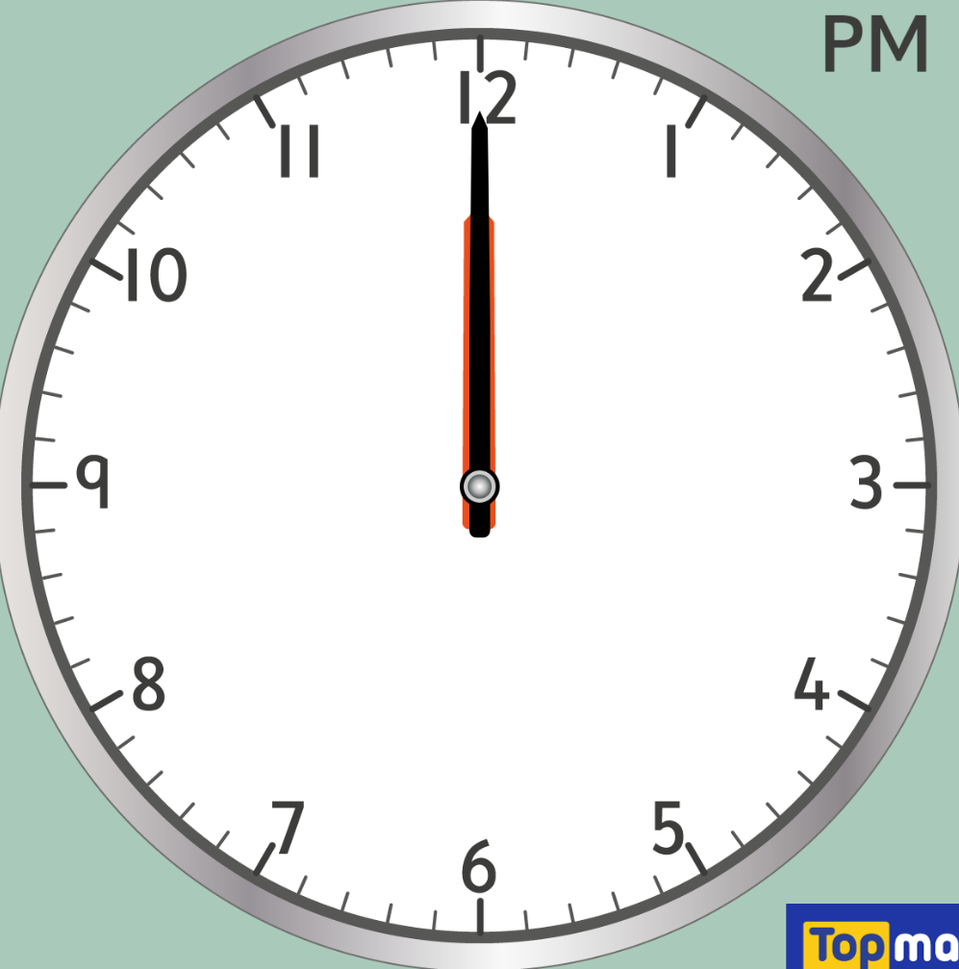
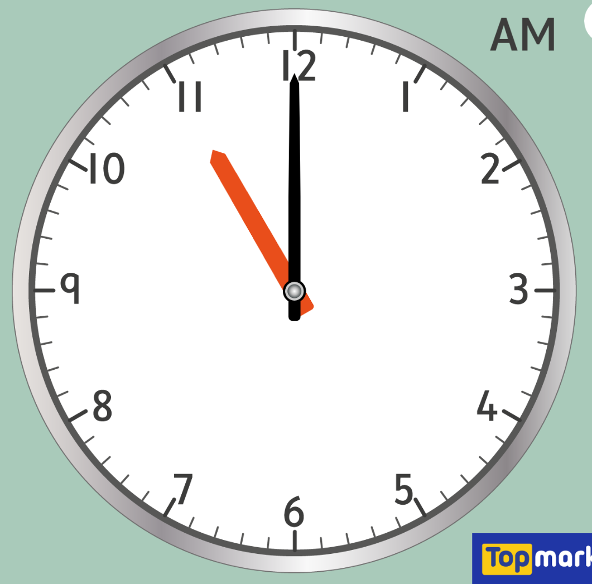
Fireworks and the law
So, if you are under the legal ages, as we saw on the previous slide, are setting off fireworks in public spaces and between these hours, you could be looking at multiple criminal offence charges in one go!!
Anyone setting off fireworks between these times can get a criminal record and up to 6 months in prison!
When it is illegal to set off fireworks?
New Years Eve
Diwali
Chinese New Year
Every other night of the year
Bonfire Night
to
to
to
AM
AM
AM
AM
PM
AM

Slide 5
Summary:
It is illegal to buy ANY firework if you are under 16
It is illegal to hold, buy or use fireworks from categories 2 and 3 if you are under 18
It is illegal to set off fireworks within or into public spaces
The age of criminal responsibility is age 10!
It is illegal to set off fireworks within the curfews set for the different times of year – up to 6 months in prison for doing so

Slide 6
Think about your future:
Criminal Damage from things like fireworks or bonfires carries a maximum sentence of up to 10 years
Committing an offence takes away your choices – Want to be a teacher? Nurse? Pharmacist? Social Worker?
Not with a criminal record!
You won’t be able to travel to America, New Zealand and many other countries if you have a criminal record
Don’t let one reckless decision take away your future!

Slide 7
Firework legalities
Prepared for Prepared by Revision Revision Date
Schools Prevention Training Team 01 September 2025

