Slide 1


Water Safety Awareness
Prepared for | Prepared by | Revision | Revision Date
Primary Schools | Prevention Training Team | 01 | November 2024

Slide 2


Objectives
To learn how to help someone in cold water
To learn what to do if you find yourself in cold water
Water Safety
SLIDE 1 of 10
Notes:
Why are we here today?
Read through the objectives one at a time.

Slide 3
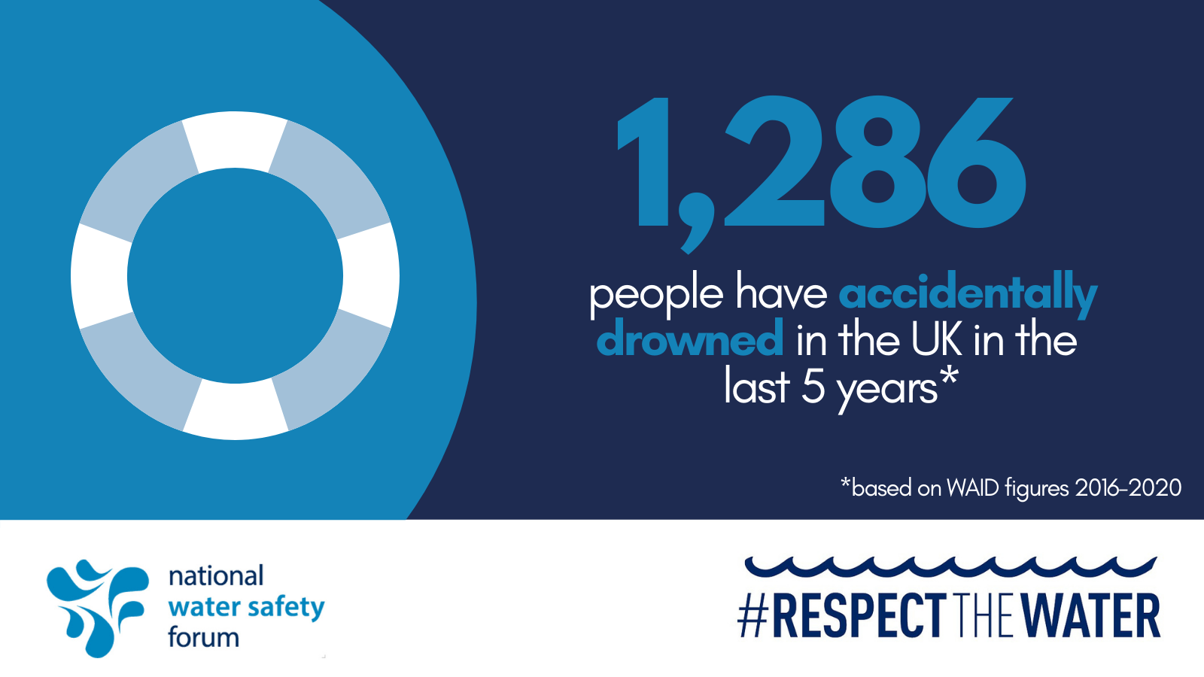
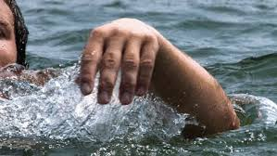
Some cold hard facts...
In 2022
105 during June, July & August
60% of deaths were in...
83% of those fatalities were MALES
226 accidental fatalities
rivers, canals, quarries & inland waters, not in the sea.
Water Safety
SLIDE 2 of 10
Notes:
Key statistics
CLICK
Read the facts on the poster
CLICK
In 2022...
CLICK
There were 226 accidental fatalities (or deaths if explaining to younger ones) in the UK in 2022:
CLICK
105 of them were in June, July and August, so that’s almost half of the year’s fatalities in only 3 months!
Out of the 226 fatalities, 151 were in England; 45 in Scotland; 22 in Wales; and 8 in Northern Ireland.
CLICK
Waters inland, such as rivers, canals, lakes, reservoirs and quarries, continue to be the leading locations for accidental drowning, with 60% of deaths.
CLICK
Males are still covering most of the deaths, accounting for 83% of accidental deaths.
Only 58% of accidental deaths were the result of recreational activities (such as water sports, boating etc).
40% people had no intention to enter the water, such as those going for a walk, where they have slipped, tripped or fallen, those being cut off by the tide, or even swept into the water by waves.
CLICK
(Information taken from: National Water Safety Forum 2022 Annual Fatal Incident Report)

Slide 4
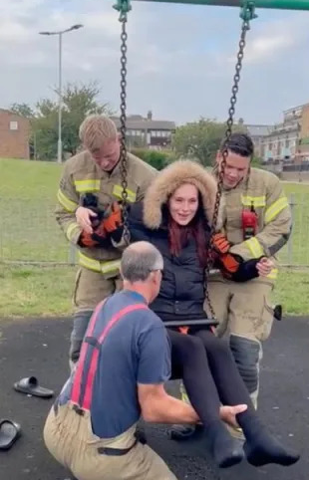
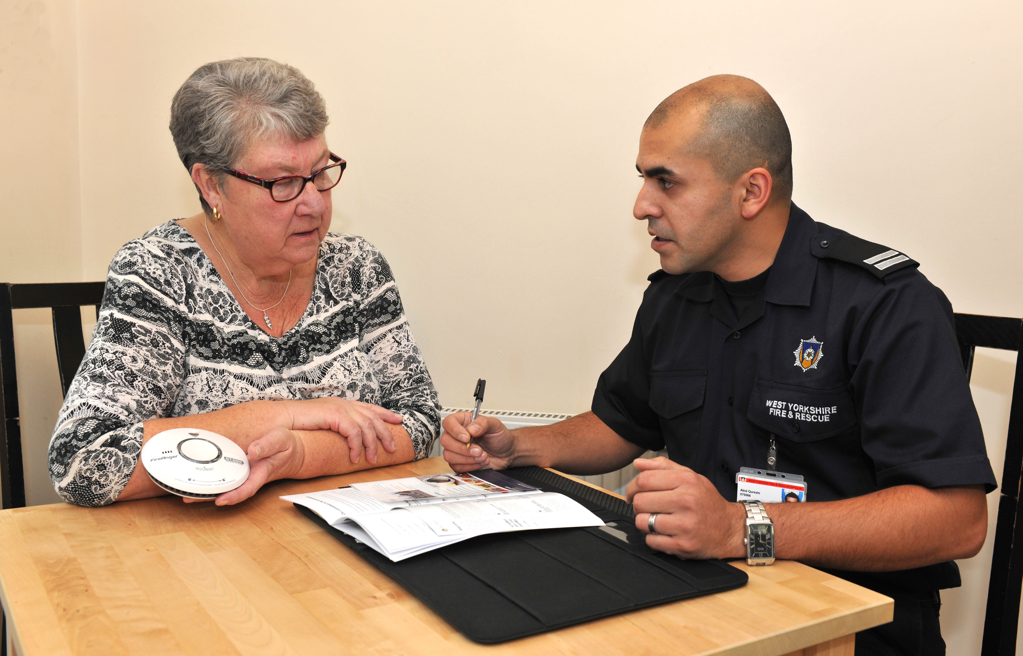
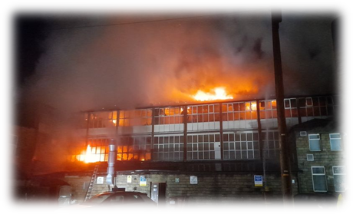
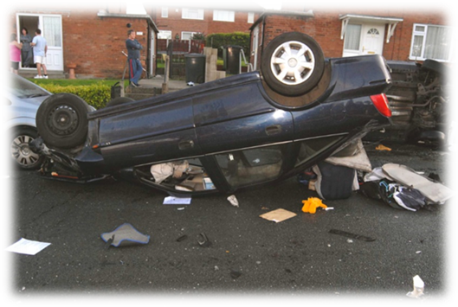
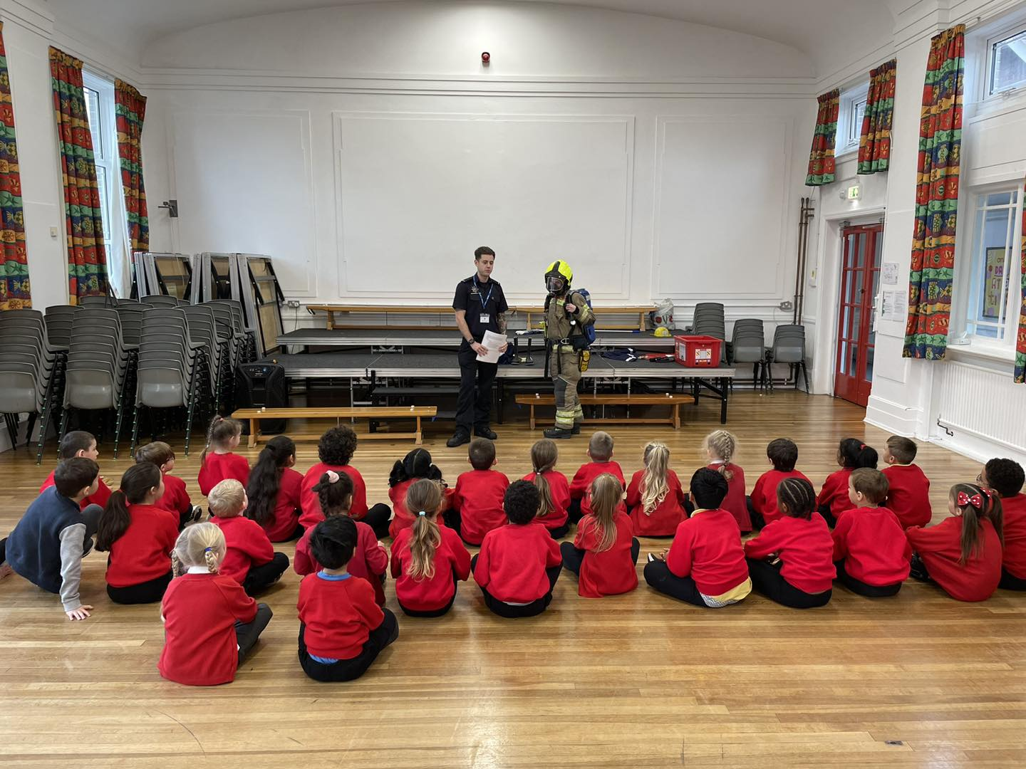
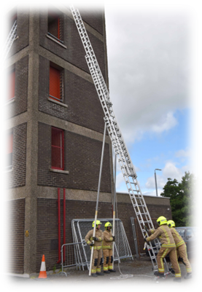
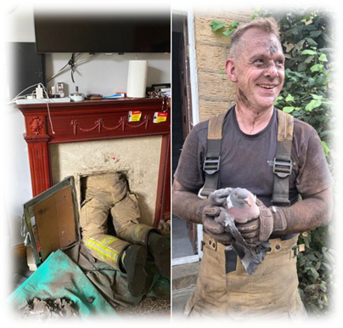
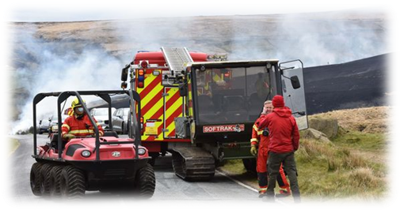
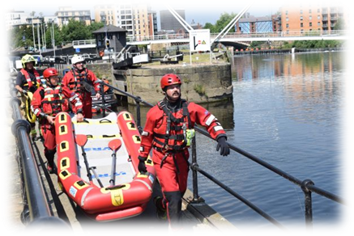
What do we do?
Water Safety
SLIDE 3 of 10
Notes:
Talk about the misconception that Fire fighters only fight fires
Before going through the pictures - Ask for hands up for answers to some of the roles FF’s undertake...can mention the different types of fires. Specifically focus on the fact that Firefighter’s do water rescue!!
Let’s have a look at how many we have that are the same. Go through each one. Warn before showing RTC image in case of any triggers for learners.
Put out and recuse from building fires
Animal rescue
Water rescue
Ongoing training
Pre-warn for next image:
RTC rescue
Wildfires
Safe and Well visits (explain briefly what these are)
School talks
People getting stuck (swings, elevators, limbs stuck in fence etc)
Explain this is why we are a “Fire AND rescue” service. We are no longer just dealing with fires.
Talk about how people often ask for police or ambulance when seeing someone in trouble in water, instead of the fire service.
Explain how police and ambulance do not do the rescuing, it is the fire service you need to be asking for when asked which emergency service you require.

Slide 5


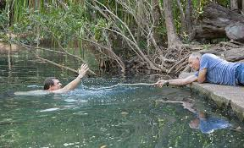
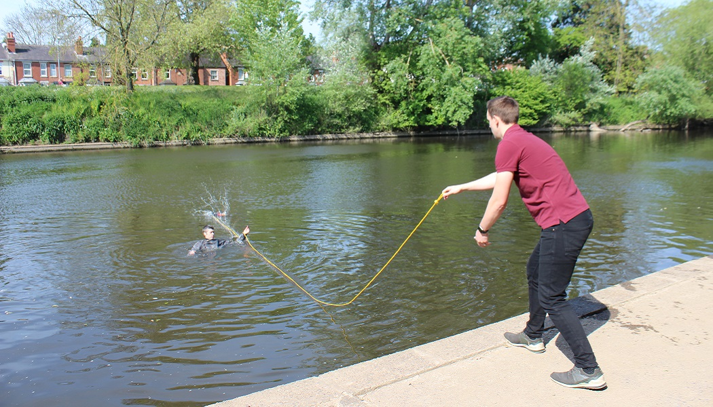

How to Help
999
Dial 999 and ask for FIRE
Talk to the person
Throw floatation devices
Reach using objects
What3Words App
Water Safety
SLIDE 4 of 10
Notes:
Talk to the person – Reassure them, keep them calm, try to encourage them to float/starfish
Reach – Try to reach the person using long poles or objects.
Lye-down near the edge instead of standing up.
Throw – Lifebuoy, Life Jacket, Throwline
Dial 999 and ask for the fire service.
Members of the public should NEVER GO IN!
WYFRS will do 3 more steps:
* Row – Find a boat or use the Fire service vessel
* Go – Go in to rescue if it’s not dangerous
* Don’t Go – If too dangerous, Do not put yourself at Risk
So, what number do we dial to ask for the fire service?
999!
CLICK
“If you see someone in trouble in the water, call 999. Ask for the FIRE SERVICE first and foremost, as they have the training and equipment necessary to help get the person out the water, as well as being first aid trained to help with the medical side of the rescue.”
CLICK
Talk to the person to keep them calm and not panic, reassure them that you have called for help and that they are on their way. Advise them to try and float using a starfish shape.
CLICK
Floatation devices such as float rings or throw-lines may be within the area. If you can get to one, use an under-arm throw to safely get it to the person, whilst continuing to hold the rope, if there is some attached.
CLICK
If there is no emergency floatation device, using an object such as a stick, pole or even a jacket/jumper, try to reach out to them with the object. Make sure you lay-down at the side of the water to stop you being pulled in too or losing balance.
So, we say: Call, Tell, Throw!
Sum up the ways to help.
Has anyone heard of the app: WHAT 3 WORDS? Clarify for those that don’t that it is an app that helps identify a more exact location within a 3-metre square which helps people find people and places more precisely. It is free to download.
CLICK
Explain that the caller should mention the app and using it to speak clearly to any 999 operator, so they know where the emergency is. If they can scan the QR code on the screen, it will take them to the app store.
CLICK

Slide 6
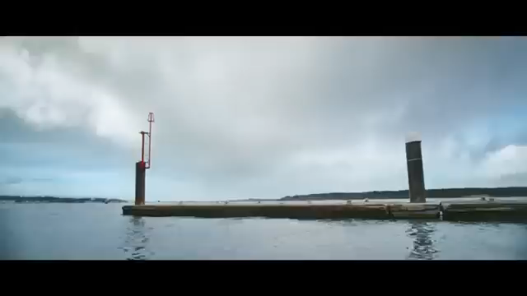
WATER SAFETY TALK
SLIDE 5 of 10
Notes:
So, let’s imagine now that it is you that has fallen in cold water. How long do you think you could hold your breath? Let’s watch a video to test it.
CLICK
CLICK after video

Slide 7
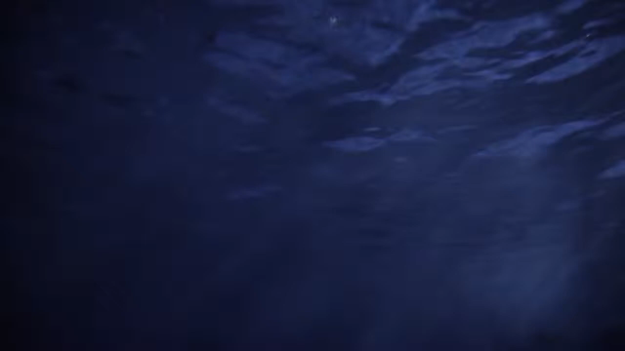
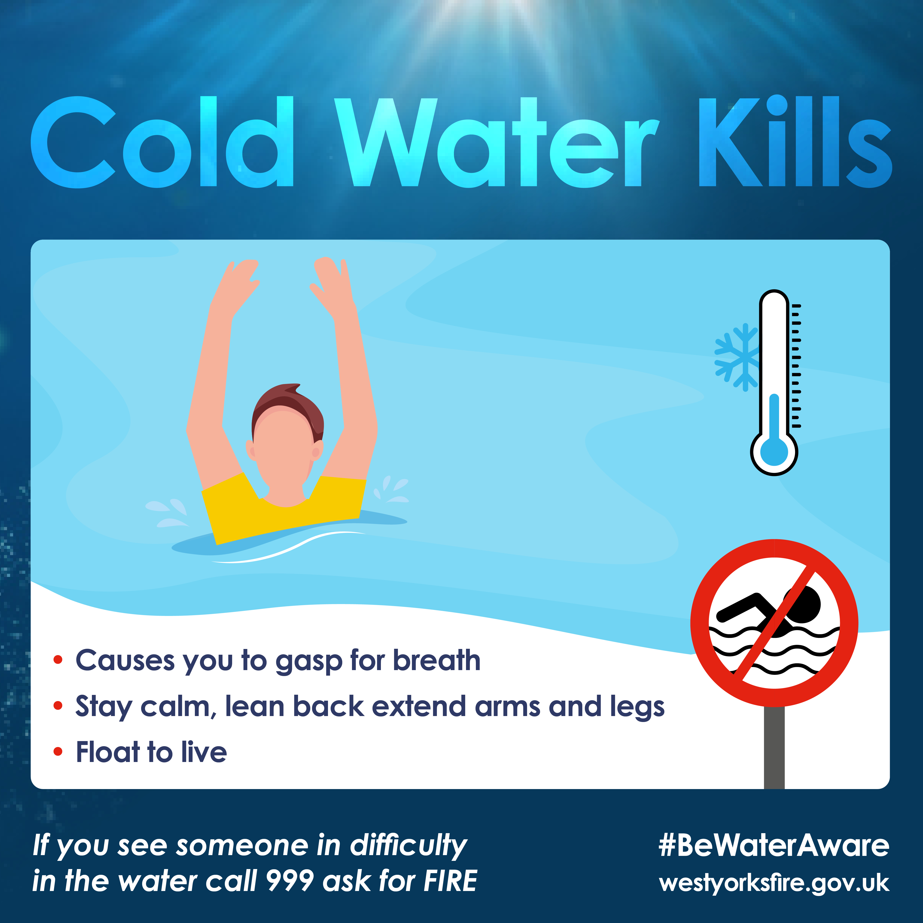
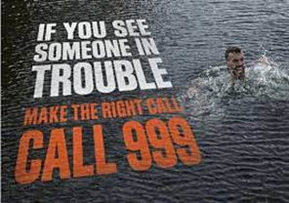
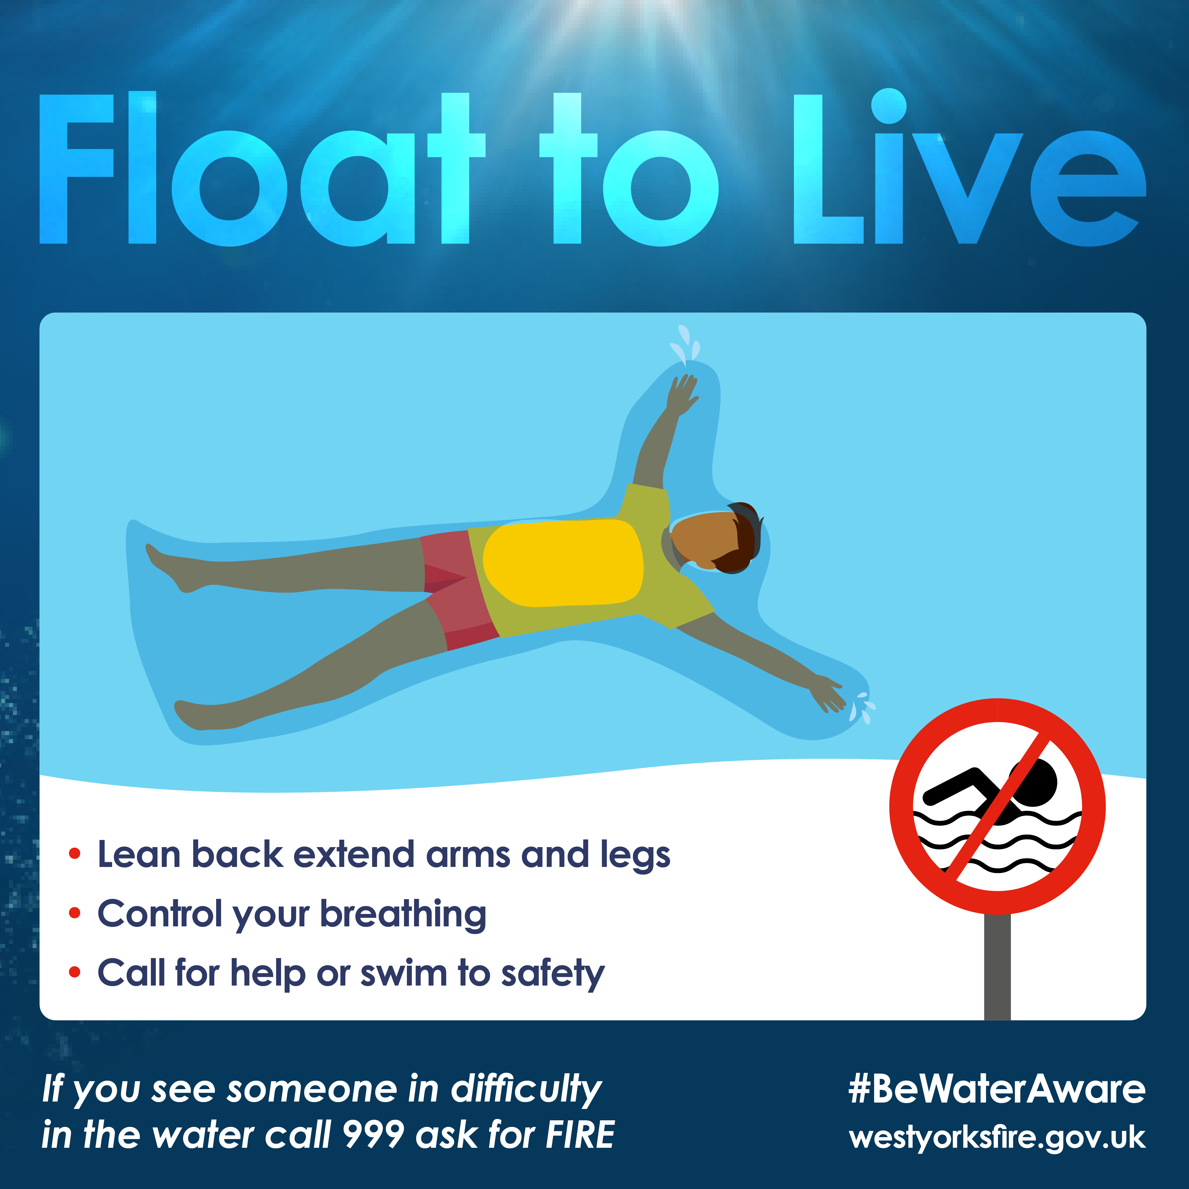
Cold Water Shock
WATER SAFETY TALK
SLIDE 6 of 10
Notes:
Cold Water kills! You have no control over how your body reacts and it can take over you. CLICK
So, what is Cold Water Shock? Some young people might be thinking “I’ve jumped into cold water before, and I was okay.”
However, falling into cold water causes an immediate gasp reflex. If your head is underwater, or you’re being hit by waves, you’ll inhale water instead of air. The initial shock can cause panic, hyperventilation (explain the definition if needed) and increased heart rate, which can lead to a heart attack.
Let’s look at the science of what it is:
- Drastic reduction in your body temperature.
- Your blood pressure goes through the roof.
- Your heart rate increases.
- Your breathing becomes fast and shallow.
All of these things together drastically reduce your ability to survive.
Cold Water Shock is not something you have control over, it is your body’s natural reaction, it doesn’t matter how “hard” you are, or how good a swimmer you are, science takes over all of that.
CLICK
If you do find yourself in trouble in cold water and are getting into difficulty, the simplest but most important advice is “Float to Live”.
You must fight your instinct to thrash around. Lean back and extend your arms and legs. Float until you can control your breathing. Only then, call for help or swim to safety.
We’ll just watch another short video to show you how to do this...
CLICK
CLICK again after video finishes
If you do see someone in trouble in the water, call 999 and ask for the FIRE SERVICE.
(However, If you are at the coast/by the sea on holiday, ask for the Coastguard.)
CLICK

Slide 8
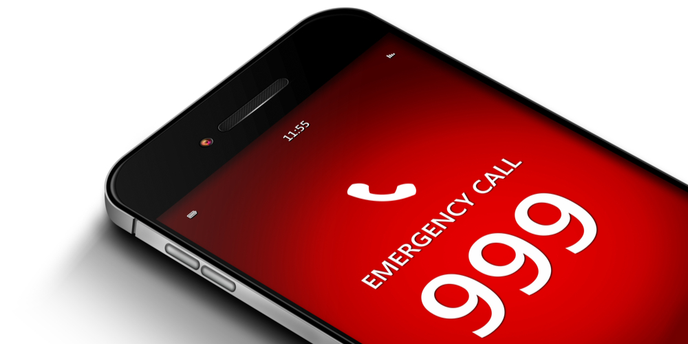
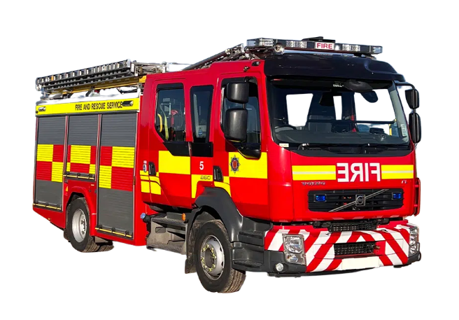
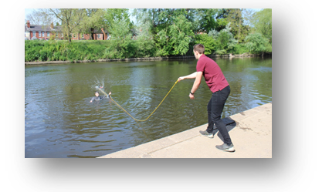
What can you remember?
What number do you dial if you see someone in trouble?
Which emergency service do you ask for when someone answers?
How can you help keep the person in trouble, calm?
What other things can you do to help, if possible?
Water Safety
SLIDE 7 of 10

Slide 9
Remember….
Water Safety
SLIDE 8 of 10
Notes:
CLICK
Recap the information on the posters and What3Words QR code reminder for those that have phones.
Finish by explaining that you don’t expect people to never go in or near open water, but there are ways they can ensure their own safety and RESPECT THE WATER;
- If open water swimming, always swim in pairs if not more, and know the areas that have been recommended or are safe.
- If at the coast, always go in the water where there is a lifeguard present
- When getting in the water, do it slowly and gradually, so your body can acclimatise to the temperature
- Do not go in the water under the influence of drink or drugs

Slide 10
Thank you for listening
Any questions?
Water Safety
SLIDE 9 OF 10
Notes:
“Thank you for listening.”
(CLICK)
“Any questions?” Take as many as you feel you have time for.
(CLICK)

Slide 11
Water Safety Awareness
Thank you for listening
Prepared for | Prepared by | Revision | Revision Date
Primary Schools | Prevention Training Team | 01 | November 2024
Notes:
THE END

