Slide 1
Fireworks and Bonfires
Y9

Slide 2
AIMS
To raise awareness of issues and consequences relating to anti-social behaviour around the bonfire period
OBJECTIVES
To state the issues arising from anti-social behaviour
To identify the risks of death or injury due to anti-social behaviour
To identify the consequences of misusing fireworks
To analyse the possible impact upon local communities

Slide 3
Anti-social behaviour
What is anti-social behaviour???

Slide 4
Example
This is the moment a thug is caught on camera hurling an industrial firework into a small off-license

Slide 5
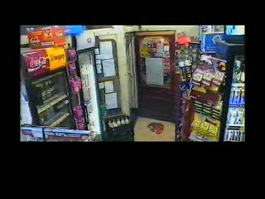

Slide 6
Awareness of others
Bonfire night is a peak time for anti-social behaviour
Fireworks are often used to threaten, intimidate and disrupt others
Bonfire night should be fun – not an excuse for setting fire to things!

Slide 7
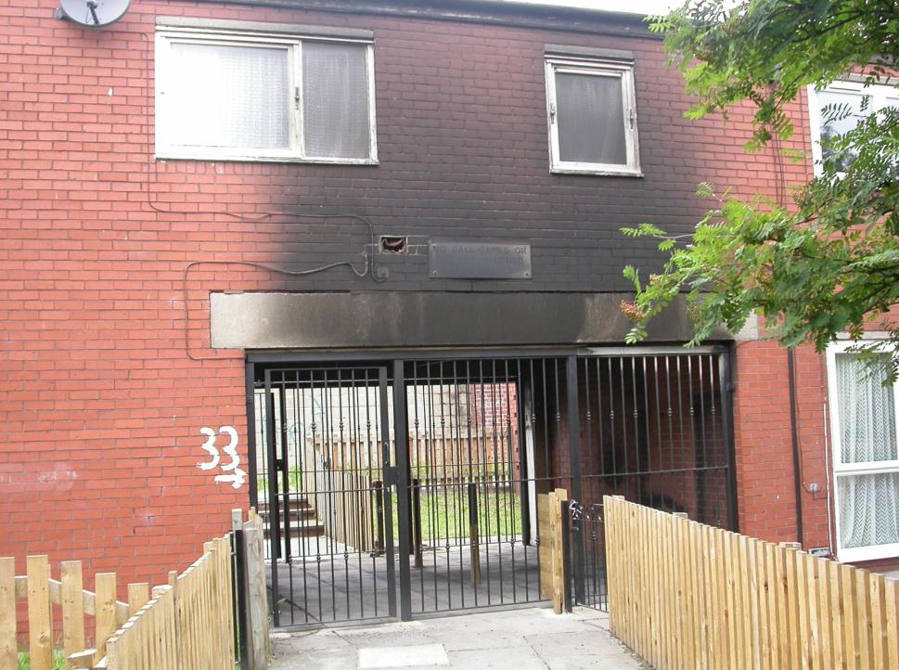

Notes:
Tell the group the story behind the image
Encourage young people to

Slide 8
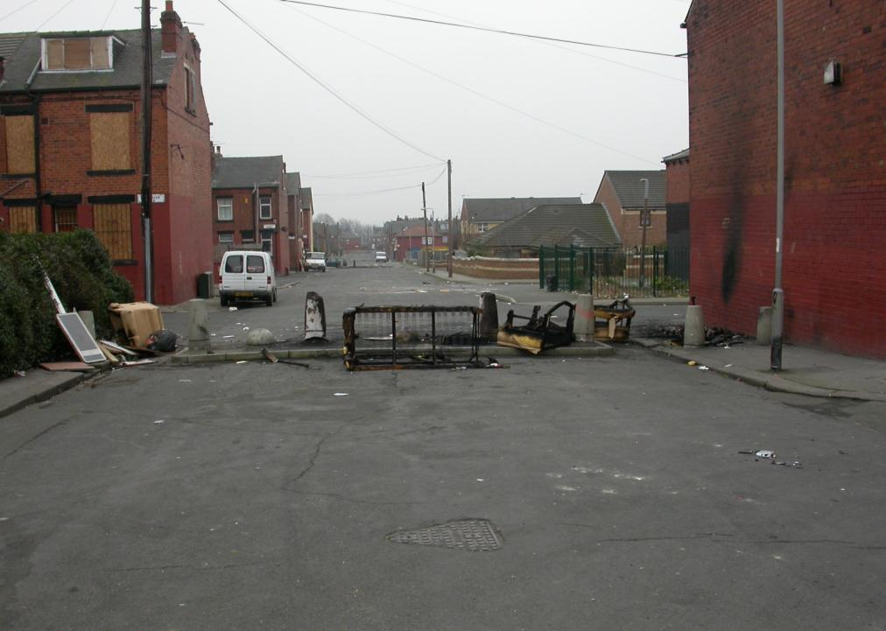
Would you like to live here?
Notes:
Picture taken from a street in Leeds
What do you think when you see this picture

Slide 9
Impact on the community
Area appearance
Environment
Bad reputation
Fear of crime

Slide 10
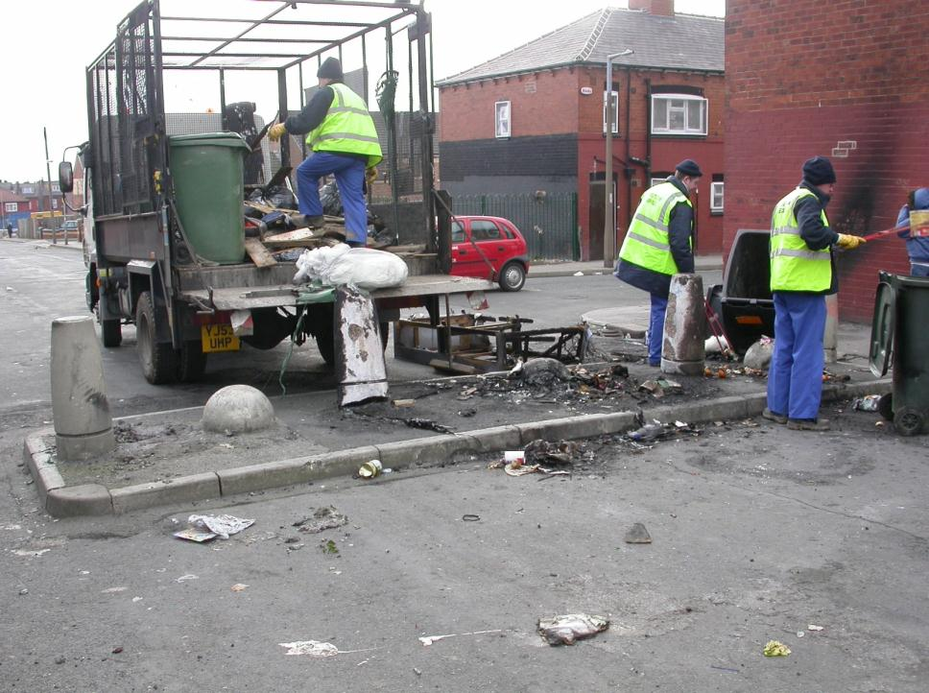
How much does this cost the community?

Slide 11
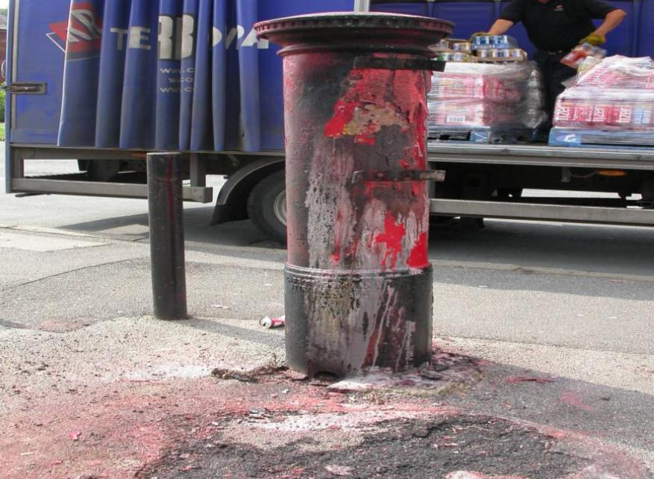
Normal life disrupted…

Slide 12
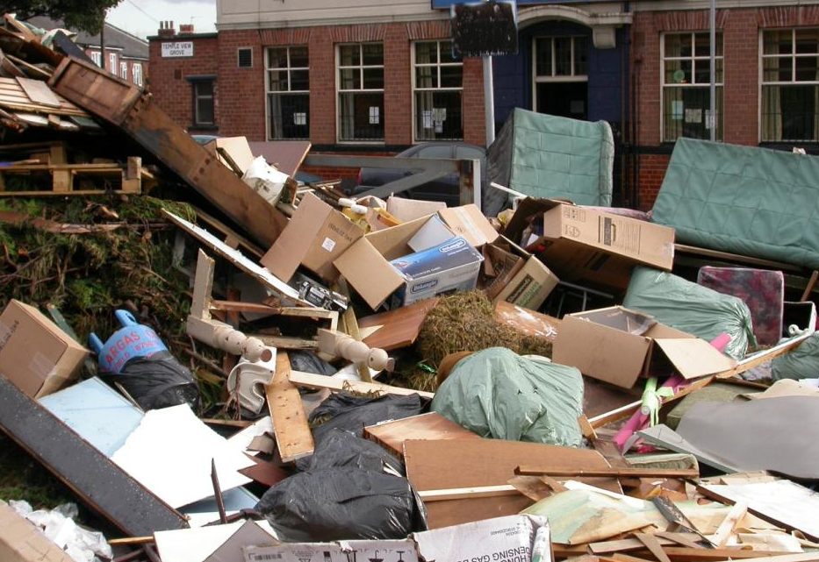
Spot the hazards…

Slide 13
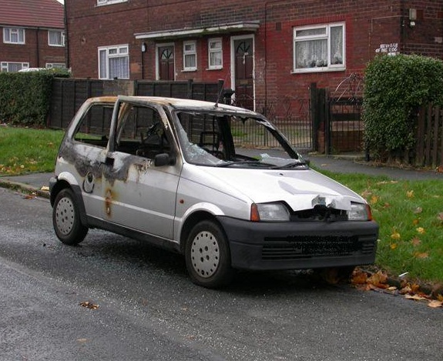
Firework fight? A joke? Arson?

Slide 14
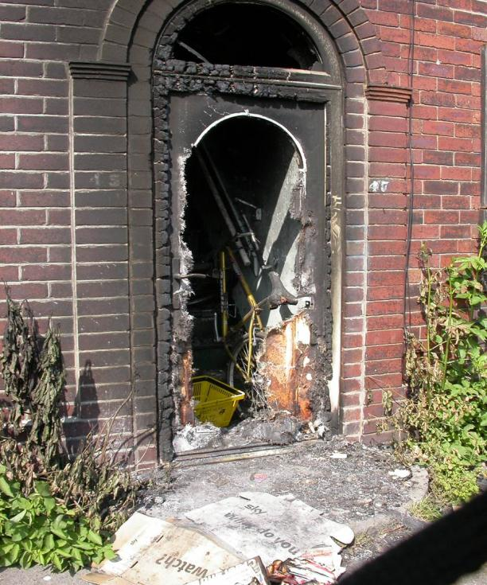
Firework thrown through a letterbox

Slide 15
Anti-social behaviour…..an example
Bullies target Raum Fox, age17, for his choice of clothing and his spotty complexion
The bullies are well known to those in the community
It’s Bonfire time and they decide to…….
Notes:
Low level anti-social behaviour
Social networking – important not to rely on this as a way of the Police getting vital information – they still need information from people to help them catch the people responsible.
The lad survived – what could have been the potential consequences of him jumping from the window?
Why do you think that his Mum didn’t jump?

Slide 16
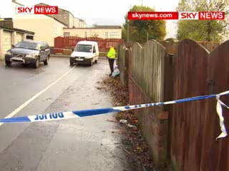

Slide 17
The consequences…..
Raum was left without his mother
The community had had enough
It was on social networking sites who the culprits were
It was easy for the Police to track down the culprits
Three teenagers were jailed

Slide 18
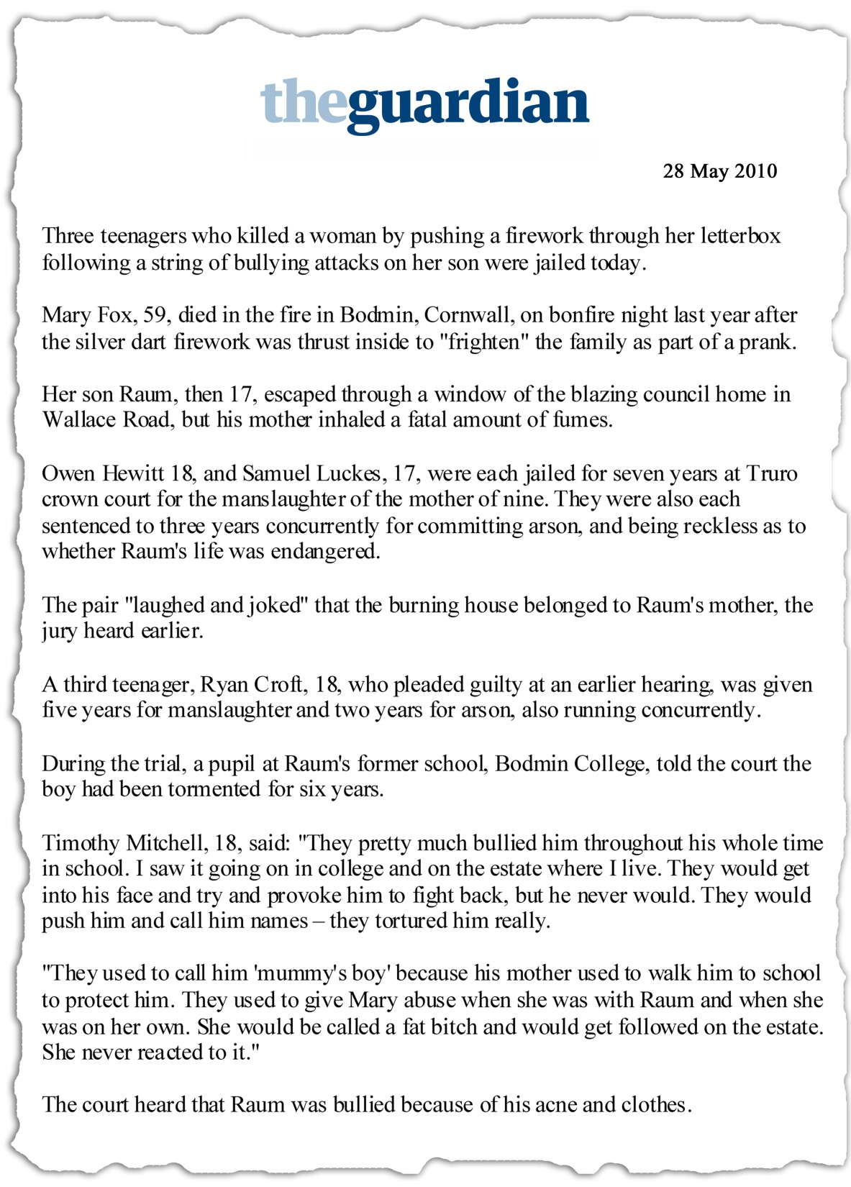

Slide 19
What do you think?
Did they intend to kill Raum?
Did they intend to kill his Mum?
What were their intentions?
Do you think the sentences were fair?

Slide 20

NO RESPECT

