Slide 1




SESSION 3: consequences
Notes:
WEST YORKSHIRE FIRE AND RESCUE SERVICE SESSION 3: CONSEQUENCES
SESSION OBJECTIVES:
Students will understand that they cannot rely on anonymity when part of a large group.
Students will understand how being seen as a positive member of society can be part of their self-identity.
Students will have a perception of firefighters as positive and relatable.
SESSION OVERVIEW:
The congregation of young people in large groups on Bonfire night is a yearly occurrence that causes chaos for law enforcement and the fire service. Often many of the young people within these groups act in a way they usually wouldn’t but do so because of the perceived safety within the crowd. However, this is not the case, and following the workshop students will understand the fragility of anonymity within groups and will realise that this cannot be relied on. Furthermore, students will reflect on their identity within their community, and will realise it is much more productive and beneficial to not be part of the crowd which causes problems on Bonfire night.
FILM SYNOPSIS: REMEMBER, REMEMBER...
In this film, we watch as Zara tells us her perspective of an incident that happened on bonfire night when she was with her friends, that affected all lives. This punchy, sometimes funny, sometimes hard-hitting account, using animation to paint a picture of the potential consequences of being at the wrong place, at the wrong time on bonfire night!
LINKS:
Please follow the link below to access a greater range of resources provided by the West Yorkshire Fire and Rescue Service surrounding teaching students about Bonfire night and Mischief night:
https://www.westyorksfire.gov.uk/

Slide 2
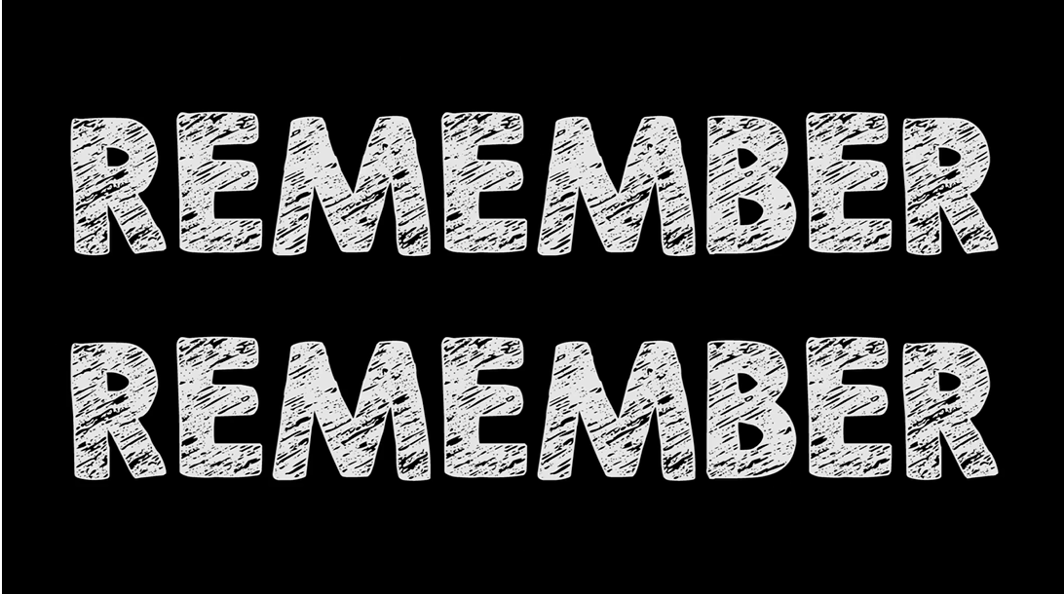
REMEMBER, REMEMBER...
Watch the film!
Notes:
FILM: “REMEMBER, REMEMBER...” (Approx. 5 mins)
Present the short film to the students before delivering the workshop.

Slide 3
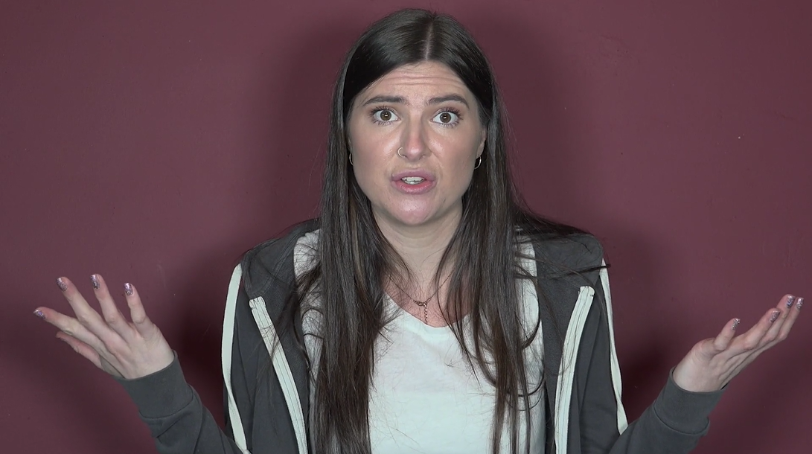
PART 1: ZARA
Notes:
PART 1:
CLASS DISCUSSION (Approx. 5 mins)
Students will analyse the film, discussing some of the key themes, such as:
[Next]

Slide 4
PART 1: ZARA
Why did Lee go to an un-organised Bonfire night?
Notes:
[Continued]
Why did Lee go to an un-organised Bonfire night, and Zara and Ash say no?
What were Lee’s reasons for going?
What were Ash’s and Zara’s reason for saying no?
Do you think Lee’s reasons were valid?
Do you think Lee understood the risk he was taking?
Whose decision do you think was the ‘normal’ decision? Ash and Zara’s, or Lee’s?
[Next]

Slide 5
PART 1: ZARA
Why did Lee go to an un-organised Bonfire night?
Did it go how he expected?
Notes:
[Continued]
Do you think he expected the night to pan out like it did?
Did Lee expect the event to end with the police / fire service being called?
Do you think he knew it might have gotten out of hand?
Do you think people go out on Bonfire night with the purpose of creating trouble?
[Next]

Slide 6
PART 1: ZARA
Why did Lee go to an un-organised Bonfire night?
Did it go how he expected?
What were some of the warning signs?
Notes:
[Continued]
What were some of the warning signs that the event he attended might not be the safest place?
This could be, the place it was hosted, who it was hosted by, whether it was organised or not, the “dodgy” characters that were supposed to be there.
The Bonfire night was a large group of young people, with no adults around.
The event was un-organised, with no safety procedures put in place.
[Next]

Slide 7
PART 1: ZARA
Why did Lee go to an un-organised Bonfire night?
Did it go how he expected?
What were some of the warning signs?
Do you think he regret his decision?
Notes:
[Continued]
Do you think Lee regretted his decision to attend?
Do you think it was a good risk / reward ratio?
Do you think he worries about getting arrested, days / weeks / even months afterwards?
Do you think he even had fun? Or did it all get out of control?
Do you think Ash or Zara regret their decision to go to an organised Bonfire night?

Slide 8
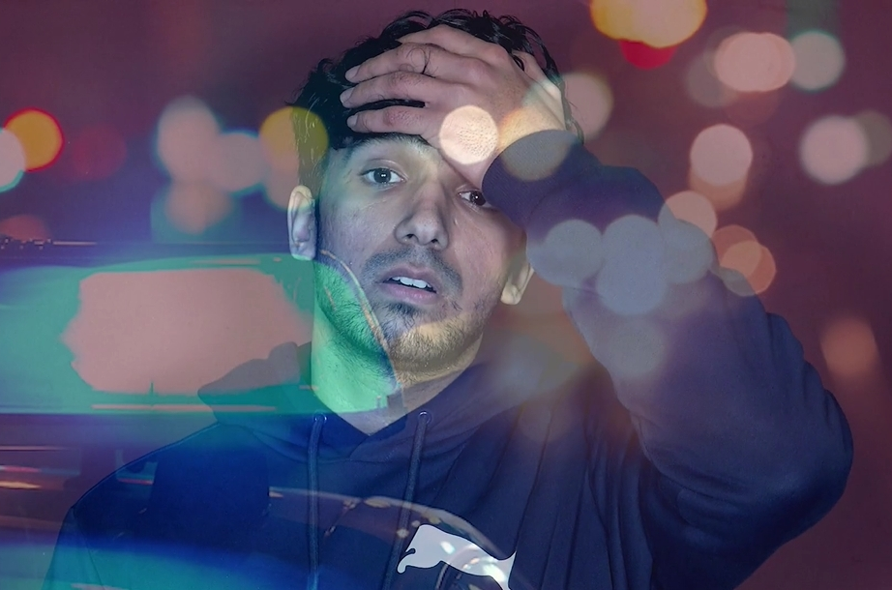
PART 2: BIG GROUPS
Notes:
PART 2:
CLASS DISCUSSION (Approx. 10 mins)
Lead a discussion regarding anonymity within large groups, focussing on the following:
[Next]

Slide 9
PART 2: BIG GROUPS
Do you feel safer in a group?
Notes:
[Continued]
Ask the students if they feel safer when part of a big groups?
If the answer is yes, discuss some of the reasons why?
If the answer is no, also ask why they feel this way?
[Next]

Slide 10
PART 2: BIG GROUPS
Do you feel safer in a group?
Do you feel accountable for your actions?
Notes:
[Continued]
Do the students think they are accountable for their actions when part of a big group?
Why might some people feel they can misbehave in a group?
Do students feel anonymous when in a group?
[Next]

Slide 11
PART 2: BIG GROUPS
Do you feel safer in a group?
Do you feel accountable for your actions?
Do you feel more confident in a group?
Notes:
[Continued]
Do students think people can get carried away when in a big group?
Why?
Does a big group pressure you into behaving in a wrong way?
Do you feel more confident than you usually would in a big group, and therefore are more likely to do something you shouldn’t?
[Next]

Slide 12
PART 2: BIG GROUPS
Do you feel safer in a group?
Do you feel accountable for your actions?
Do you feel more confident in a group?
Consequences
Notes:
[Continued]
Following this, get students to quickly write down what they think some of the consequences would be on their personal lives, of getting caught doing something illegal on Bonfire night.
Afterwards, get students to feedback some of these consequences, before asking the following about the film:
Do you think Lee could get in trouble with the law by being part of the big group, despite not doing anything personally?
If Lee wasn’t arrested on the night, do you still think he could get in trouble with the law in the future?
Conclude this section by explaining to students that even by being part of a group that does something unlawful, you can be guilty by association, and receive the same consequences as the individual.
Explain to students that all of us feel safer in a group – herd mentality is a natural instinct – but in actual fact, with the advances in technology (include facial recognition), the risk of you getting caught are astronomically higher than they have ever been before – and even 6 months after the last Bonfire night, police are still arresting people who congregate in groups performing illegal and anti-social behaviour.

Slide 13
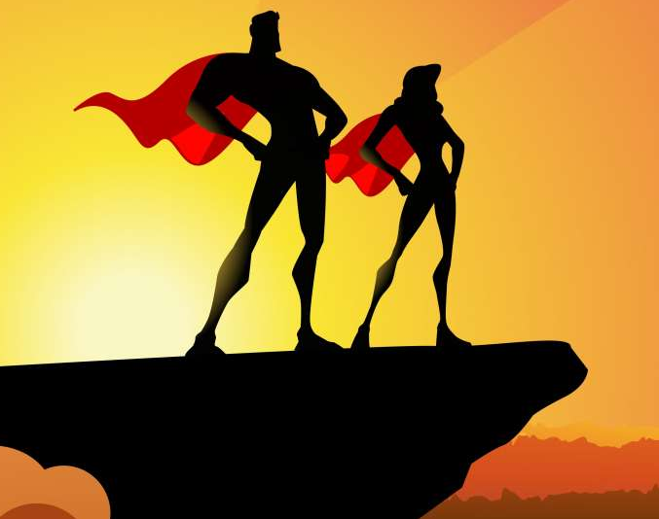
PART 3: IDOLS
Notes:
PART 3:
GROUP DISCUSSION (Approx. 10 mins)
In pairs, or individually, gets students to first write down people they look up to and respect, examples include:
Their parents
Their extended family
Celebrities
People in their local community
[Next]

Slide 14
PART 3: IDOLS
Who do you respect?
Notes:
[Continued]
Get students to discuss how these “idols” behave:
How are they seen in the local community?
What are some of their positive characteristics?
Why do students perceive these people as “idols”?
[Next]

Slide 15
PART 3: IDOLS
Who do you respect?
How do they behave?
Notes:
[Continued]
Next, get students to discuss how they behave:
Do they express similar behaviours?
Is it important that they express positive behaviours?
Is being seen as a positive member of their local community something that they want?
How would their “idols” want them to behave?
Are there times / situations in which they don’t behave in the ways their “idols” would want them to?
[Next]

Slide 16
PART 3: IDOLS
Who do you respect?
How do you behave?
How do they behave?
Notes:
[Continued]
Next, get students to discuss how they behave:
Do they express similar behaviours?
Is it important that they express positive behaviours?
Is being seen as a positive member of their local community something that they want?
[Next]

Slide 17
PART 3: IDOLS
Who do you respect?
How do you behave?
How do they behave?
How do your idols want you to behave?
Notes:
[Continued]
Finally, ask students to think about how their “idols” would want them to behave:
Are there times / situations in which they don’t behave in the ways their “idols” would want them to?
Would they be embarrassed to tell their “idols” how they have acted in some situations?
Do they think it is important to be seen in a good way by your “idols”?
Get students to feedback to the rest of the class.
Conclude the discussion by highlighting that all of the “idols” students discussed behave in very similar, positive, ways. Furthermore, all of their “idols” want students to behave in a way that makes them become a positive member of the community.
There may be times when you find yourself in situations, such as Zara did in the film, which may affect how people perceive you. Consequently, when in these situations, it may be beneficial to ask yourself “would the people I care about, want me to act in the way I am currently doing” – and if the answer is no, the correct decision might be to remove yourself from that situation.
[Next]

Slide 18
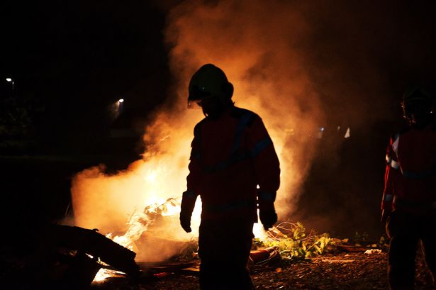
PART 4: THE FIRE SERVICE
Notes:
PART 4:
GROUP DISCUSSION (Approx. 10 mins)
Firstly, get students to discuss the perception of firefighters within the film, focussing on the following:
[Next]

Slide 19
PART 4: THE FIRE SERVICE
Why did the Fire Service turn up at Zara’s Bonfire night?
Notes:
[Continued]
Why do you think the Fire Service turned up to the bonfire in the film?
What is their job?
What is their intentions?
Do you think they should have turned up?
What could / would have happened if they didn’t show up?
[Next]

Slide 20
PART 4: THE FIRE SERVICE
Why did the Fire Service turn up at Zara’s Bonfire night?
Were they in danger of harm?
Notes:
[Continued]
Do you think the Fire Service were in danger of harm?
If you said no, why not?
If you said yes, explain why?
Who / what was putting them in danger?
[Next]

Slide 21
PART 4: THE FIRE SERVICE
Why did the Fire Service turn up at Zara’s Bonfire night?
Were they in danger of harm?
Do you think the way the Fire Service were treated was correct?
Notes:
[Continued]
Do you think the way the Fire Service were treated was correct?
How were they treated?
Why were they treated like this?
Is it fair that they were treated in this way, when they were trying to keep people safe?
Would you ever treat someone in the Fire Service this way?
[Next]

Slide 22
PART 4: THE FIRE SERVICE
Why did the Fire Service turn up at Zara’s Bonfire night?
Were they in danger of harm?
Do you think the way the Fire Service were treated was correct?
Who is part of the Fire Service?
Notes:
[Continued]
Who is part of the Fire Service?
Is there a specific type of person who joins the fire service?
If they are not in uniform, how could you tell someone was in the fire service?
Would / could any of your family be part of the fire service?
Do you think members of the fire service are people’s brothers / sisters / parents / sons / daughters?
At the end of this discussion, explain to students that members of the fire service could be anyone in your community, even people you personally care about. There is no “specific” type of person who joins the fire service, just people who care about the safety of members (including you) of their community.
[Next]

Slide 23
PART 4: THE FIRE SERVICE
Why did the Fire Service turn up at Zara’s Bonfire night?
Were they in danger of harm?
Do you think the way the Fire Service were treated was correct?
Who is part of the Fire Service?
For a member of the Fire Service, what does a perfect Bonfire night look like?
Notes:
[Continued]
Following this, in pairs, ask students to describe a “perfect Bonfire night” from the perspective of a member of the Fire Service:
What would this look like?
Would anyone end up in hospital?
Would people end up arrested?
Would organised and proper Bonfire nights be cancelled?
Get students to feedback to the class their answers, and why they think that is the case.
Explain to students that a perfect night for a member of the Fire Service is one in which Bonfire nights were controlled and safe, and one in which everyone was out of danger.
[Next]

Slide 24
PART 4: THE FIRE SERVICE
What if it happened to you?
Notes:
[Continued]
Next, still in pairs, get students to discuss their dream job (try and vary the jobs in which they discuss, i.e. not everyone can be a footballer), asking the following questions:
What is their dream job?
What are some of the responsibilities of this job?
What would some of the consequences be of not performing your job correctly?
Could you perform your job correctly if someone / something was intentionally trying to hinder you?
How would you feel if you were put in danger of harm when trying to complete your job?
Conclude the session by explain that the Fire Service’s sole purpose is to keep you safe, and just as many of you discussed when planning your dream job, actions like we saw in the film not only makes their job harder to complete, but also puts them at serious risk.
[Next]

Slide 25
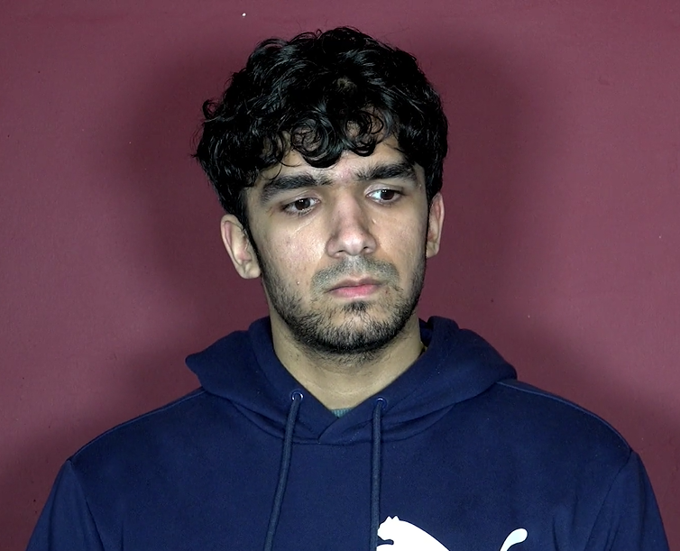
PART 5: CONCLUSION
Anonymity within groups doesn’t exist
The people you respect and idolise want you to be a positive member of the community
The Fire Service wants to keep you safe, not ruin your fun
Notes:
PART 5:
CLASS DISCUSSION (Approx. 5 mins)
Conclude the session by thanking students for their contributions, and re-iterating the following:
Anonymity within groups doesn’t exist in the context of Bonfire night.
Being a positive member of the community is something you should want to be.
Fire fighters are just normal people, trying to keep you safe, and you should remember that before doing something that puts them at risk.
Finally, we all want students to have a fun Bonfire night, at the end of the day, it’s a celebration. We all want students to wake up the day after Bonfire night, with no serious consequences to contend with after behaving in a way that they now regret.

Slide 26
EVALUATION
HANDS UP!
Notes:
EVALUATION
Please access the link below and complete the evaluation for the session, simply asking to the students to raise their hands for their chosen answer, and recording these numbers in the spaces provided:
https://forms.gle/qf9h37UefXaA5nWM6

