Slide 1





Notes:
WEST YORKSHIRE FIRE AND RESCUE SERVICE SESSION 2: BONFIRE NIGHT
SESSION OBJECTIVES:
Students will be able to identify and cope with peer pressure and influence.
Students will be made aware of the dangers associated with congregating in large groups on bonfire night.
Students will understand the danger of buying and using illegal fireworks.
SESSION OVERVIEW:
Bonfire night can be fun when attending an official and organised event where robust risk assessments and safety precautions have been put in place. However, when young people congregate in public spaces, a combination of poor behaviour, bad decision-making and the use of illegal fireworks can lead to significant risk to personal safety as well as their chances of being charged with a criminal offence. This session focusses on getting young people to understand what they can do to have an enjoyable, positive and above all safe bonfire night.
FILM SYNOPSIS: MEET LEE!
Meet Lee. Lee’s got a bunch of interests – he likes to keep busy and he likes to have a laugh. But when Lee gets bored, he ends up looking for stuff to do – unfortunately that means hanging about the streets with characters that aren’t that cool, such as ‘Danny’s older brother’ – a guy in his 20’s that sells illegal fireworks out the back of his car – and a gang of shady-looking lads who Lee’s always trying to impress. In this funny, short film we explore why it is Lee always ends up in trouble and bonfire night and how he can avoid it in the future!
LINKS:
Please follow the link below to access a greater range of resources provided by the West Yorkshire Fire and Rescue Service surrounding teaching students about Bonfire night and Mischief night:
https://www.westyorksfire.gov.uk/
ADDITIONAL NOTES:
Please note, you have also been sent a Teacher Information Sheet, which provides you on useful facts and figures regarding arson in the UK, plus top tips on general safety during Bonfire Night. This sheet will need to be used during the discussion in Part 3.

Slide 2
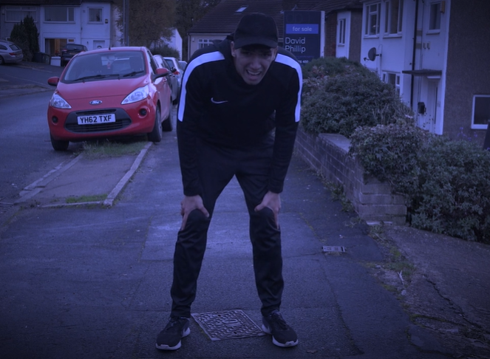
PART 1: MEET LEE
Notes:
PART 1:
CLASS DISCUSSION (Approx. 5 mins)
Lead a discussion about the character Lee in the film, focussing on the following:
[Next]

Slide 3
PART 1: MEET LEE
What do you think of Lee?
Notes:
[Continued]
What did we think of Lee and why?
Do we think he is a responsible character?
Do you think he made the right decisions?
[Next]

Slide 4
PART 1: MEET LEE
What do you think of Lee?
What do you think about the people he hangs around with?
Notes:
[Continued]
What did we think of the people Lee was hanging around with and why?
How did they compare to Lee?
Do we think they were good people to hang around with?
What do we think about their decisions?
[Next]

Slide 5
PART 1: MEET LEE
What do you think of Lee?
What do you think about the people he hangs around with?
Why does Lee hang around with them?
Notes:
[Continued]
Why did Lee choose to hang around with them?
Why does Lee choose to associate with these kinds of people?
Does Lee act like he usually does around these types of people?
Does he do things he usually wouldn’t, just to try and fit in?
Conclude this section by highlighting how the people Lee is choosing to hang around with, perhaps are a bad influence on him – making him act in a way he wouldn’t usually, and might get him into trouble.

Slide 6
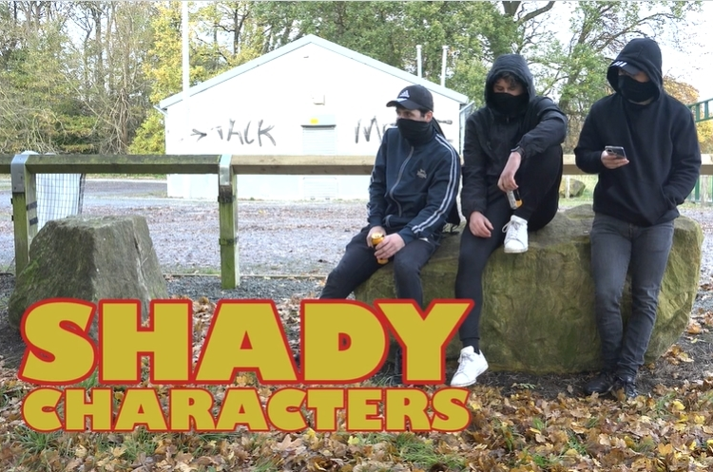
PART 2: WRONG CROWDS
Notes:
PART 2:
GROUP DISCUSSION (Approx. 10 mins)
Lead a discussion about the problems of meeting up with large groups on Bonfire night, focussing on:
[Next]

Slide 7
PART 2: WRONG CROWDS
Do you feel safe in a big crowd?
Notes:
[Continued]
Do you feel safer when in a big crowd?
Why might you feel safer?
Do you feel like you can get away with more than you usually would?
[Next]

Slide 8
PART 2: WRONG CROWDS
Do you feel safe in a big crowd?
Was Lee more or less likely to get in trouble?
Notes:
[Continued]
Was Lee more or less likely to get into trouble on bonfire night hanging about in a gang?
Going back to the previous discussion, do you think Lee was more likely to get in trouble with the big gang, or with his friend Ash?
Do you think Lee would act in a way he wouldn’t usually when in a big crowd?
Do you think a big crowd gave him too much confidence, meaning he took more risks?
Give examples from the film.
[Next]

Slide 9
PART 2: WRONG CROWDS
Do you feel safe in a big crowd?
Was Lee more or less likely to get in trouble?
What's the difference between a big crowd at an organised event?
Notes:
[Continued]
What’s the difference between a big crowd at an organised event and a gang / crowd on the street?
Do you think one is safer than the other?
Why might one be safer than the other?
[Next]

Slide 10
PART 2: WRONG CROWDS
What are the consequences?
Notes:
[Continued]
Next, split students into pairs or small groups and ask them to develop a list of consequences for Lee from hanging about with the characters from the film. Ask them to consider:
What dangerous behaviour might he have gotten involved with?
What criminal behaviour might he of inadvertently been involved with?
What would the consequences of be? (For example, Lee’s health, school, his future, impact on Lee’s family and friends).
Groups feed back to the rest of the class for further discussion.
[Next]

Slide 11
PART 2: WRONG CROWDS
What are the consequences?
Will you get caught?
Notes:
[Continued]
Finally, discuss with the group how likely they think they are to get arrested by the police as follows:
If they commit a criminal act?
If they are present when a criminal act is committed by somebody else?
If they are present but believe they are anonymous when a criminal act is committed.
Conclude the discussion by highlighting to students that – thanks to technology (like facial recognition cameras) being present in a group in which somebody commits a criminal act can and does lead to your arrest (even several months following an incident).
So even though Lee may not have done anything illegal, just by being part of that group means he’s just as culpable and can be arrested.

Slide 12
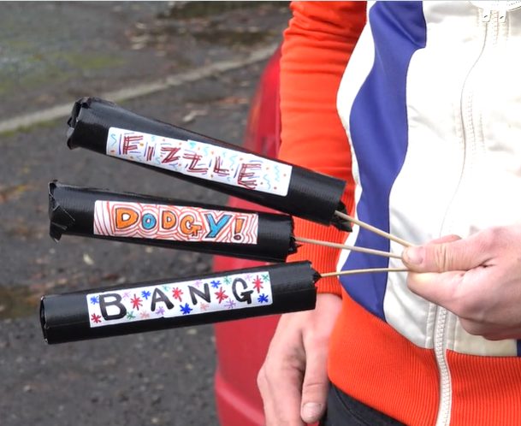
PART 3: FIREWORKS
Notes:
PART 3:
CLASS DISCUSSION (Approx. 5 mins)
Move the discussion on to specifically focus on the illegal use of fireworks on and around bonfire night:
[Next]

Slide 13
PART 3: FIREWORKS
Danny’s older brother
Notes:
[Continued]
What do we think of Danny’s older brother in the film?
Do we admire him, look up to him and why?
What do we think of Lee for hanging about with him?
[Next]

Slide 14
PART 3: FIREWORKS
Danny’s older brother
What sort of person sells illegal fireworks?
Notes:
[Continued]
What sort of person would sell illegal fireworks to younger people?
What words would we use to describe that person?
What sort of connotations are linked with this kind of person, in the eyes of the rest of society?
Is this a type of person you aspire to become?
[Next]

Slide 15
PART 3: FIREWORKS
Danny’s older brother
Risk / Reward ratio
What sort of person sells illegal fireworks?
Notes:
[Continued]
Following this, move the discussion towards the specific dangerous of illegal fireworks, such as what the Risk / Reward ratio for buying and using illegal fireworks would be:
The risk can be far reaching – such as serious permanent injury to yourself, or serious legal implications related to arson.
Whereas, the reward is the exact same if you bought a legitimate firework.
Conclude the discussion by referring back to the previous point, that even if you have no intention of buying and using illegal fireworks on Bonfire night, if the people you are hanging around with use illegal fireworks, you can still be held accountable by association, and could face the same consequences – either with the law, or with your personal safety.
LINKS:
Use the Teacher Information sheet to highlight to students the “Do’s and Don’ts” for firework use on Bonfire night, reiterating the consequences for improper use and arson.

Slide 16
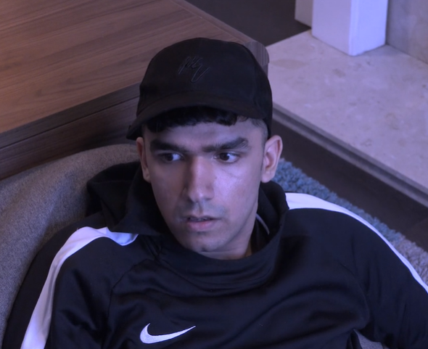
PART 4: UNDER PRESSURE
Notes:
PART 4:
CLASS DISCUSSION (Approx. 7 mins)
Lead a discussion on how young people can identify and deal with peer pressure.
Firstly, get students to write down their answers to the following questions:
LINKS:
Use the following resources to access information made available surrounding peer pressure, and influence. Including what peer pressure looks like, what the negative effects could be, how to cope with the effects of peer pressure, how to identify those students at high risk of negative peer influence and at what point you should raise concern:
https://youngminds.org.uk/media/1513/young-minds-coping-with-school.pdf
https://www.bbc.co.uk/cbbc/joinin/handling-peer-pressure
[Next]

Slide 17
PART 4: UNDER PRESSURE
What is peer pressure?
Notes:
[Continued]
What is peer pressure?
Peer pressure is the feeling of being pressured into something that you don’t want to do.
It is common in adolescents, but also affects adults and can continue throughout life.
[Next]

Slide 18
PART 4: UNDER PRESSURE
What is peer pressure?
How do you know when you are being affected?
Notes:
[Continued]
How do you know when you’re being affected by peer pressure?
Peer pressure can come in many different forms and is often expressed in varying level of severity.
It isn’t always done by bullies or people trying to hurt you – it can often come from friends.
If anyone is consistently promoting you to do something that you are not comfortable with, then that is a form of peer pressure.
[Next]

Slide 19
PART 4: UNDER PRESSURE
What is peer pressure?
How do you know when you are being affected?
What can you do?
Notes:
[Continued]
What can you do when peer pressure becomes a problem?
The best course of action to take if you feel you are being peer pressured is to say no.
If it persists, you should evaluate whether the people pressuring you are the people you should spend your time with.
If you feel it is severe, reach out to the multiple support lines available, such as Childline who provide aid for students who feel subject to intense peer pressure, or talking to friends / family / people of authority you trust such as teachers.
[Next]

Slide 20
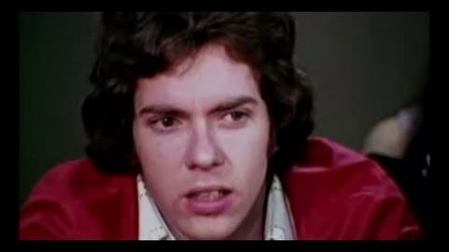
PART 5: BAD INFLUENCE
Notes:
PART 5:
CLASS DISCUSSION (Approx. 7 mins)
Move the discussion on to peer ‘influence’ and ask students how it differs from peer pressure.
Initially, get students to watch the video on the Asch Experiment, and ask them the following:
LINKS:
Please find below the video on the Asch Experiment:
https://www.youtube.com/watch?v=qA-gbpt7Ts8
[Next]

Slide 21
PART 5: BAD INFLUENCE
How does influence differ from pressure?
Notes:
[Continued]
How does peer influence differ from peer pressure?
Peer influence is when our actions subconsciously influence the actions of those around us – in many cases this is harmless and affects what clothes we wear or what music we listen to, etc.
Peer pressure is when we intentionally try to change or affect someone's behaviour.
[Next]

Slide 22
PART 5: BAD INFLUENCE
How does influence differ from pressure?
In what ways was Lee influenced in the film?
Notes:
[Continued]
In what ways was Lee influenced in the film?
By hanging around with the wrong groups, he strayed away from the fun things he wanted to do: play games, rap, etc – and instead did things he might not have felt comfortable doing, just to fit in, i.e. buy illegal fireworks, hang around outside of places at night, etc.
[Next]

Slide 23
PART 5: BAD INFLUENCE
How does influence differ from pressure?
In what ways was Lee influenced in the film?
Why do you need to know when you’re being influenced?
Notes:
[Continued]
Why is it important to be able to identify when we’re being influenced? Especially around Bonfire night?
Peer influencing is happening all the time, from friends and strangers, so it feels normal and unremarkable but it’s important to note that we are also influencing those around us.
Peer influence can lead to us making bad choices that put ourselves at risk.
At bonfire night, this could mean hanging around with groups you wouldn’t usually, or doing dangerous activities to fit in. These could all lead to significant harm.
Conclude the discussion by establishing the importance of being able to identify when you are being influenced in a negative way, so you can avoid performing the wrong behaviour.

Slide 24
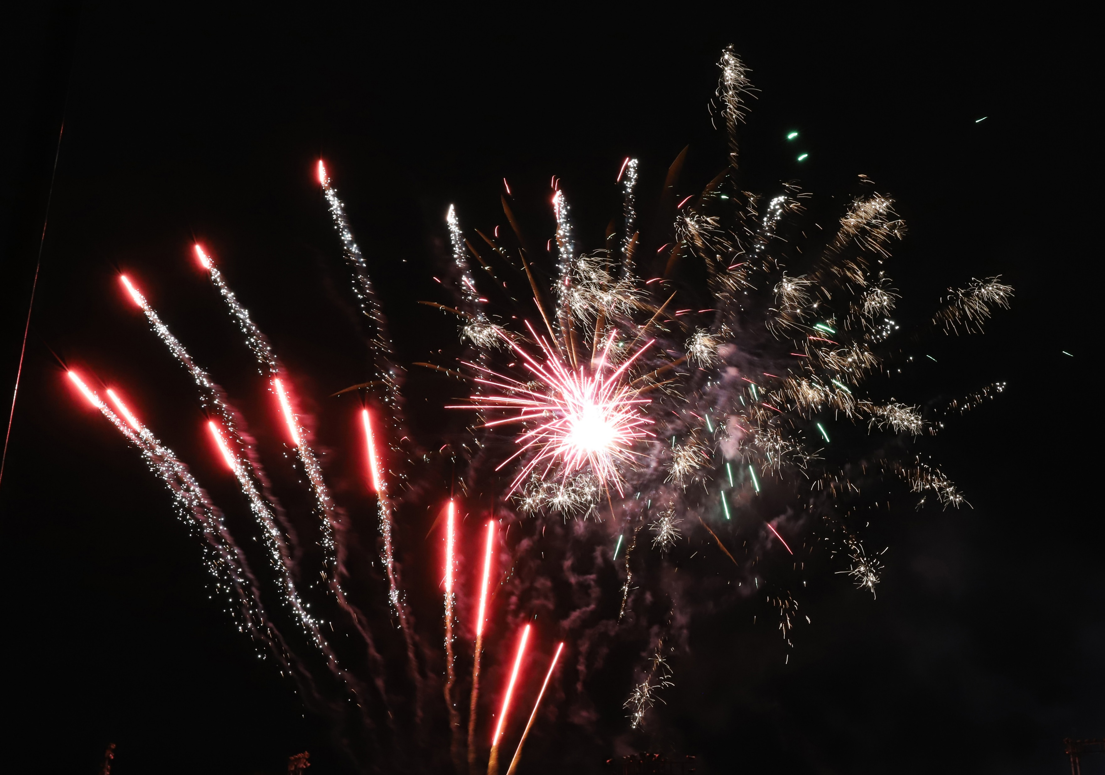
PART 6: BONFIRE NIGHT
Your Perfect Bonfire Night
Where do you spend it?
Who do you spend it with?
How safe is it?
What happens when you get home?
Notes:
PART 6:
ACTIVITY (Approx. 5 mins)
Conclude the session by getting students to generate their own descriptions of a perfect bonfire night, including:
Where they spend it.
Who they spend it with.
How safe they feel during.
What happens when they get home.
Get some students to feedback to the class, and finish with the notion that a few, small, correct decisions can ensure that your ‘Perfect Bonfire night’ is achieved.

Slide 25
EVALUATION
HANDS UP!
Notes:
EVALUATION
Please access the link below and complete the evaluation for the session, simply asking to the students to raise their hands for their chosen answer, and recording these numbers in the spaces provided:
https://forms.gle/bktnQBGCdnpW8v3v5

