Slide 1





Notes:
WEST YORKSHIRE FIRE AND RESCUE SERVICE SESSION 1: MISCHEIF NIGHT
SESSION OBJECTIVES:
Students will be able to critically assess the choices and decisions they make to keep themselves safe.
Students will understand the potential consequences of risk-taking behaviour and the negative risk/reward ratio.
Students will develop methods and techniques to avoid dangerous or risky situations.
SESSION OVERVIEW:
During October and November, with mischief night and the build up to bonfire night, students need to understand how even small decisions they make can put them at significant risks. This session aims to help students critically assess why we sometimes make decisions that work against our self-interest, and what we can do to make better decisions and keep ourselves safe. They will also develop an understanding of the risk/reward ratio and how friends influence our ability to make good choices.
FILM SYNOPSIS: MISCHEIF
Ash has a dilemma; it’s mischief night and he’s getting pressured to go out with his best mate, Lee. He knows going out will increase his chance of getting into trouble, and he wants to do the right thing to keep himself safe and not jeopardise his future or the relationship he has with his girlfriend, Zara. However he’s also worried about what Lee and his other mates will think of him. In this film Ash learns how important it is to make the right choices, even when it’s difficult.
LINKS:
Please follow the link below to access a greater range of resources provided by the West Yorkshire Fire and Rescue Service surrounding teaching students about Bonfire night and Mischief night:
https://www.westyorksfire.gov.uk/
ADDITIONAL NOTES:
Please note, you have also been sent a Teacher Information Sheet, which provides you on useful facts and figures regarding arson in the UK, plus top tips on general safety during Bonfire Night. This sheet will need to be used during Part 3 and the Conclusion to the session.

Slide 2
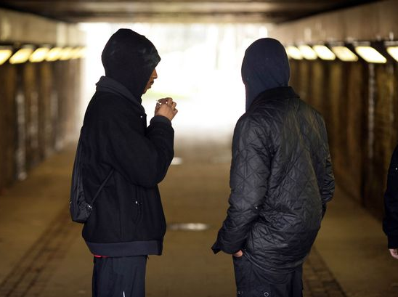
PART 1: THE DILEMMA
Notes:
PART 1:
ACTIVITY: (2 mins)
Play the film ‘Mischief: Part 1’.
CLASS DISCUSSION (Approx. 8 mins)
Lead a discussion about Ash’s dilemma in Part 1 of the film, focussing on the following:
[Next]

Slide 3
PART 1: THE DILEMMA
What should Ash do?
Notes:
[Continued]
What should Ash do?
Should he go out with Lee, despite saying he doesn’t want to?
What do we think Ash will do? Why?
If he decides to go out, even though he doesn’t want to, why is he making that decision?
[Next]

Slide 4
PART 1: THE DILEMMA
What should Ash do?
What does Lee want Ash to do?
Notes:
[Continued]
Move on to discuss how Lee pressures Ash to come out with him.
What does Lee want Ash to do?
What does Lee want Ash to do?
Is Lee respecting Ash’s choice to want to stay in?
What does he say or do in order to pressure Ash into coming out with him? (For example; blaming his girlfriend, telling him he’s being boring, saying people are talking behind his back).
[Next]

Slide 5
PART 1: THE DILEMMA
What should Ash do?
What does Lee want Ash to do?
Who is the dominant force?
Notes:
[Continued]
Who is dominant in this relationship and why?
Does Ash stand up to Lee? Is he successful and getting Lee to listen to him / accept his decision?
What does Lee do to exert dominance over Ash, ie, get him to change his mind?
At the end of the call, who has managed to influence the other one to change their mind more? Is this a sign of dominance?
Do you think Ash knows Lee is dominant or is this happening subconsciously?
[Next]

Slide 6
PART 1: THE DILEMMA
What should Ash do?
What does Lee want Ash to do?
Who is the dominant force?
Is Lee a barrier to Ash’s safety?
Notes:
[Continued]
Does Lee make it difficult for Ash’s to make his own decisions?
Does Lee pressuring Ash to change his mind put his friend at more or less risk?
Do we think Lee cares about why Ash doesn’t want to come out? Which of them cares more about Ash’s safety?
What other barriers can we think of in general life that affect our ability to make good choices? (For example, peers, social media).
How easy / difficult is it for us to overcome barriers and make the choices we want to make?
CONCLUSION:
Conclude the discussion by highlighting how being able to identify pressure or negative influences is important when you are trying to make good decisions – decisions that benefit you. Friends may not always understand your point of view, or be putting your best interests first (as with Lee in the film). Identifying and dealing with pressure like this is vital, especially when you don’t feel capable of expressing your true feelings.
LINKS:
Use these links to access information made available surrounding peer pressure, and influence. Including what peer pressure looks like, what the negative effects could be, how to cope with the effects of peer pressure, how to identify those students at high risk of negative peer influence and at what point you should raise concern:
https://youngminds.org.uk/media/1513/young-minds-coping-with-school.pdf
https://www.bbc.co.uk/cbbc/joinin/handling-peer-pressure

Slide 7
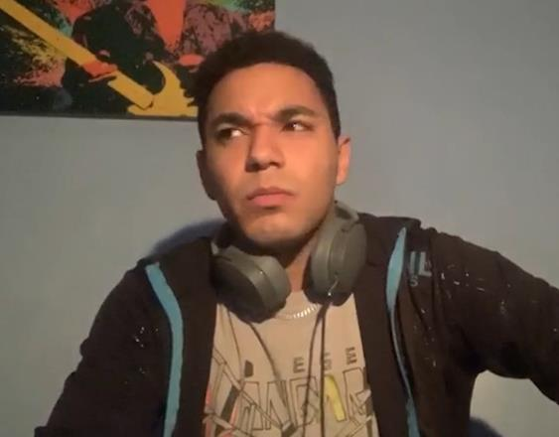
PART 2: THE DECISION
Notes:
PART 2:
ACTIVITY: (2 mins)
Play the film ‘Mischief: Part 2’.
CLASS DISCUSSION (Approx. 8 mins)
Lead a discussion about the conversation between Ash and Zara in Part 2 of the film, focussing on:
[Next]

Slide 8
PART 2: THE DECISION
What do we think of Lee?
Notes:
[Continued]
How is Lee being perceived in this part of the film:
What does Ash think of Lee?
What does Zara think of Lee?
Whose perception of Lee do you agree with, and why?
Do we think Lee knows they think of him like this, would he be happy with that?
[Next]

Slide 9
PART 2: THE DECISION
What do we think of Lee?
What do we think of Ash?
Notes:
[Continued]
What Ash says to Zara during the film:
Why do you think Ash is still considering going out with Lee, despite saying he didn’t want to in Part 1?
Is Ash wrong to change his mind? Do you think he needs to stick up for himself like Zara said?
Why might Ash find it hard to stand up to Lee and stick to his original choice?
[Next]

Slide 10
PART 2: THE DECISION
What do we think of Lee?
What do we think of Ash?
Who is the better friend?
Notes:
[Continued]
Who is the being a good mate out of three characters?
Who is the better mate out of Lee and Ash? Why?
How does Ash try to influence Lee and is it positive? (For example, suggesting he doesn’t hang out with Danny, asking him if he wants to stay in and play Xbox etc).
What kind of influence do we think we are on our mates, positive and negative? Does it always work? If not, does trying to be a positive influence still make you a good mate?
CONCLUSION:
Conclude the discussion by highlighting that Lee’s negative influence on Ash isn’t necessarily deliberate, he may just be thoughtless and not really listening to his mate. A good mate would listen, respect, accept and it is useful for us to observe how our mates influence us and then manage the relationship accordingly. This doesn’t mean Ash should stop seeing Lee, but be aware that certain situations with Lee puts him at unnecessary risk so avoid those situations (especially around Mischief Night and Bonfire Night).

Slide 11
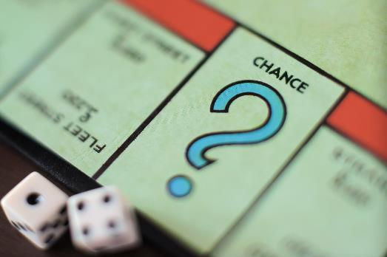
PART 3: THE CONSEQUENCES
Notes:
PART 3:
ACTIVITY: (2 mins)
Play the film ‘Mischief: Part 3’.
CLASS DISCUSSION (Approx. 8 mins)
Lead a discussion exploring what happens in the third and final part of the film, focussing on the following:
[Next]

Slide 12
PART 3: THE CONSEQUENCES
Did Ash make the correct decision?
Notes:
[Continued]
Did Ash make the correct decision when he went out?
Did Ash intend to meet up with Lee, and should he of stayed when things escalated?
How did Ash benefit from going out with Lee?
Was he right to leave when he did? Should he have left sooner? What might have happened if he’d stayed?
What did Zara think of his decision? Do you think she was right in thinking Ash had handled the situation badly?
[Next]

Slide 13
PART 3: THE CONSEQUENCES
Risk-taking behaviour
Did Ash make the correct decision?
Notes:
[Continued]
Move the discussion forward, focussing on the topic of risk taking behaviour:
What do we think constitutes risky behaviour?
What examples of risky or dangerous behaviour did we hear about throughout the film?
What other risky behaviour might we see around Mischief and Bonfire night?
[Next]

Slide 14
PART 3: THE CONSEQUENCES
Risk-taking behaviour
Did Ash make the correct decision?
Risk / Reward ratio
Notes:
[Continued]
Explain to students what the Risk / Reward ratio is:
The risk / reward ratio is the trade off between the supposed reward of performing a behaviour, compared to it’s risk. For example, the reward of performing anti-social behaviour around is that people who see you will think of you as funny / cool / someone that want to hang around with, whereas the risk could be getting expelled / getting arrested / getting in trouble. Often around Bonfire and Mischief night, the risk of performing a behaviour massively outweighs the reward.
Following this, discuss the following:
In the film, Lee obviously enjoyed taking risks – what risky behaviour did Lee enjoy and what do we think he believed the reward would be?
Do we think, in the end, Lee thought the reward was worth the risk? (For example, the way Lee’s manner changed at the end of Part 3 of the film).
Did Ash properly consider the risk/reward ration when he decided to go out with Lee?
What could be some of the further consequences for Ash and Lee?
LINKS:
Access the link below to gain further information regarding risk taking behaviour in students, and why they are more likely to perform risky behaviour in return for an increase in their image with peers:
https://parents.au.reachout.com/common-concerns/everyday-issues/risk-taking-and-teenagers
CONCLUSION:
Conclude the discussion by referring to the Teacher Information sheet regarding arson, and explain some of the facts and consequences of being charged with arson. Following this, explain to students that despite the fact that initially Ash didn’t want to go out, now he will be as culpable as Lee when it comes to the consequences of what happened. At this time of year, around Mischief Night and Bonfire Night, there is a significant increase of risk when hanging around in groups, and even if you don’t commit any crimes yourself, there is a significant increase in your chancecs of being caught or hurt, just by being present.
[Next]

Slide 15
ROLE PLAY
ACTIVITY!
Notes:
PART 4:
ACTIVITY (Approx. 10 mins)
Separate students into pairs or small groups and tell them, they are going to take part in a roleplay activity. The activity will help them generate a bank of methods Ash could’ve used to avoid a risky situation like the one in the film.
The role-play should be enjoyable but rigorous, so encourage students to challenge each other robustly.
Students choose to be either Ash or Lee in the following situation:
Lee is pressuring Ash to come out with him and some other mates.
Ash doesn’t want to go out as he wants to stay out of trouble.
The roles can also be swapped to give all students the chance to experience both positions.
ADDITIONAL NOTES:
During the roleplay, instead of students focussing on what they would be uncomfortable saying (as it’s not always easy saying “no” to mates), they should focus on what they realistically can and would be prepared say, for instance:
Make an excuse! Maybe Ash can’t come out because he’s babysitting, or he’s hurt his leg at football, or he’s been grounded…
Change the subject! Get off the subject quickly, not giving Lee the chance to pursue it.
Offer a better activity! Try and influence Lee to do something else instead that would be a lot more rewarding.
Following the role-play, students’ feedback to the class about what happened, any observations they made and how this might be useful taking forward into their own lives.
LINKS:
Use this link to access practical tips on how to introduce role-playing activities into the classroom. This includes the benefits of role-play, as well as the parameters that need to be set out in order to achieve success:
https://www.teachingenglish.org.uk/article/role-play

Slide 16
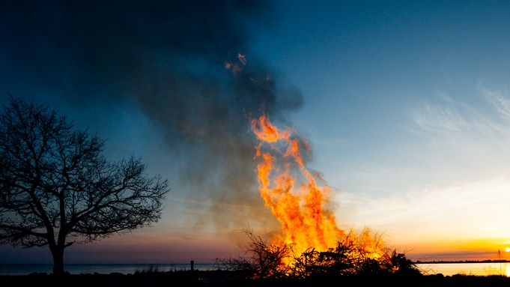
CONCLUSION
Notes:
PART 5:
CLASS DISCUSSION (Approx. 5 mins)
Conclude the session by recounting the objectives of the session, and what students have learnt during discussion. Use this point to highlight any important facts regarding mischief night, including any specific issues relating to your school / area.
Additionally, you may find it beneficial to refer to the Teacher Information sheet and give pupils helpful tips on how to stay safe around fireworks and bonfires.

Slide 17
EVALUATION
HANDS UP!
Notes:
EVALUATION
Please access the link below and complete the evaluation for the session, simply asking to the students to raise their hands for their chosen answer, and recording these numbers in the spaces provided:
https://forms.gle/zLR3rWs7Su7p5ifC6

